Slide 1
Ceramics Notes
Hand Building Techniques

Slide 2
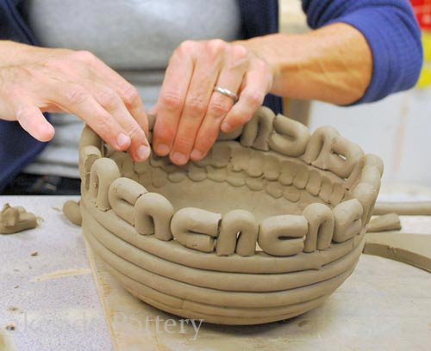
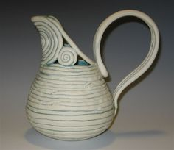
Coiled Pottery
- One of the oldest ways of forming pottery. Long strands/snakes/coils of clay which are laid on top of each other and joined through slipping and scoring.

Slide 3
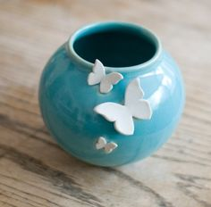
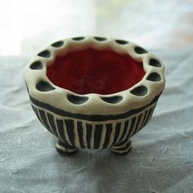
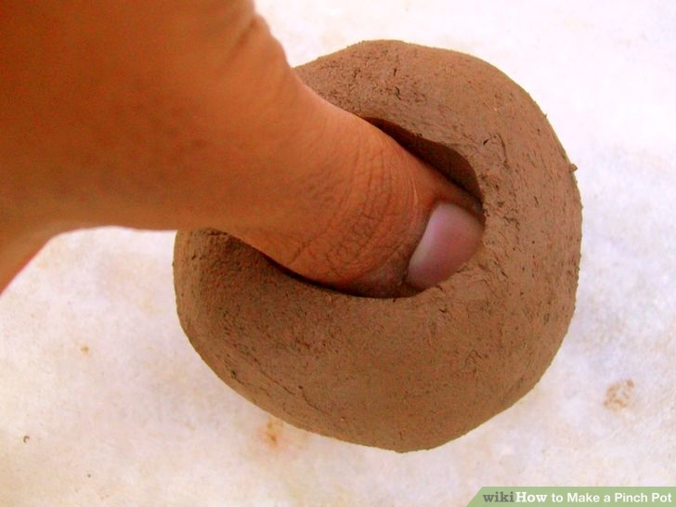
Pinch Pots
- Starting with a ball of clay the potter opens a holeinto the ball and forms a bowl shape through a combination of stroking and pinching the clay.

Slide 4
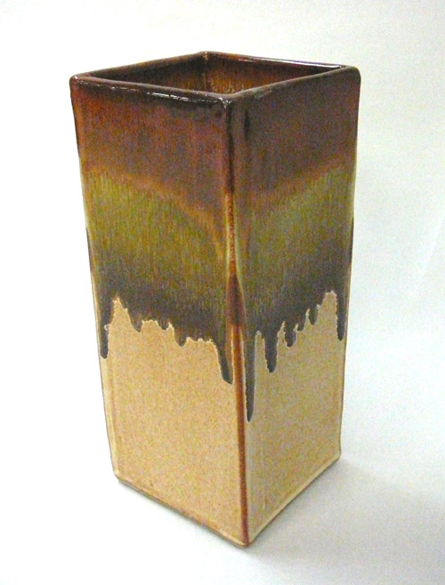
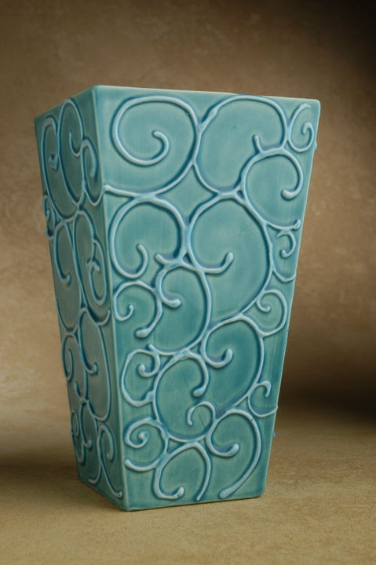
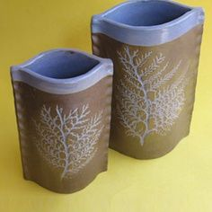
Slab Built
- Clay slabs are cut to shape and joined together using leather hard and wet clay called slip. Slabs can be draped over or into forms, rolled around cylinders or built up into geometric forms.

Slide 5
Stages of clay
Green ware – Clay that has not been fired.
Wet clay – Clay in a moist state.
Firing – Heating a kiln to bake ceramics
Leather hard clay – Clay in a firm but sufficiently moist state to permit joining.
Bone dry clay – Clay in a dry state and ready to be bisque fired.
Bisque – The first firing of clay, gets All remaining water/moisture out of clay.

Slide 6
Finishing and joining Techniques
Score and Slip – A method of joining two pieces of clay together. Scoring is when cuts/scratches are made in the two pieces of clay that are intended to be joined. Slip is added to one side of the scored clay and then the two pieces are joined together. The slip acts like glue. This method does not work on bone dry and fired clay
Slip – super wet clay. It is often the consistency of thick cream.
Glaze - A coating of material applied to ceramics before the 2nd firing that forms a glass/shiny or colored surface. Glazes can be colored, opaque, translucent or matte.
Sgraffito - This comes the Italian word meaning “to scratch" and is done by incising or cutting a design through a colored slip or glaze to reveal the clay body. We will be using this similar method to carve designs into the clay body itself.

Slide 7
The kiln
Kiln - The oven in which ceramics are fired.
Kiln Wash - used to coat kiln shelves to protect them from dripping glaze.
Kiln Shelves - The shelves inside a kiln that ceramic are placed on.
Shelf Supports - Thick pegs/stilts used to hold shelves in a kiln.
Pyrometric Cones ( cones) - These are slender pyramids of ceramics material made to measure and indicate when a firing is nearly finished or completely finished.

