Slide 1
Color theory
Color harmony

Slide 2
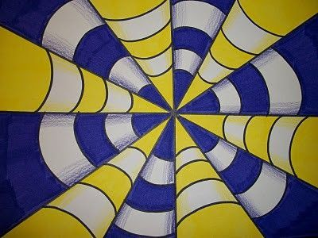
Color Scheme Based on Complimentary Colors
Using Complimentary Colors/Contrast Colors to “POP” the image

Slide 3
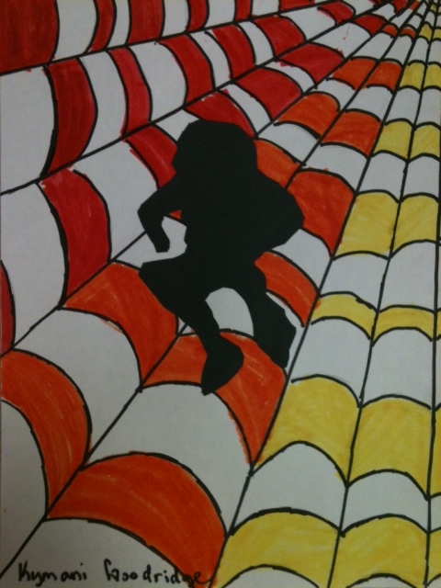
Color Scheme Based on Analogous Color
Analogous colors are any three colors which are side by side on the color wheel

Slide 4
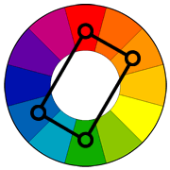
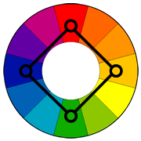
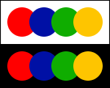
Rectangle or Square color scheme
uses four colors arranged into two complementary pairs.

Slide 5
Warm colors and cool colors
Warm colors are vivid and energetic, and tend to advance in space.
Cool colors give an impression of calm, and create a soothing impression.

Slide 8
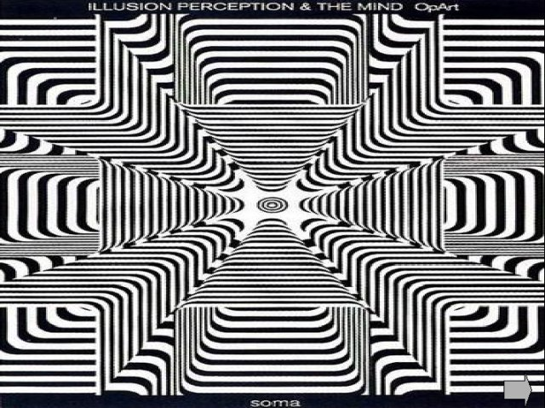

Slide 15
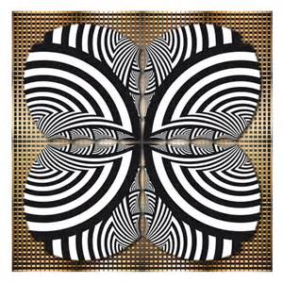

Slide 16
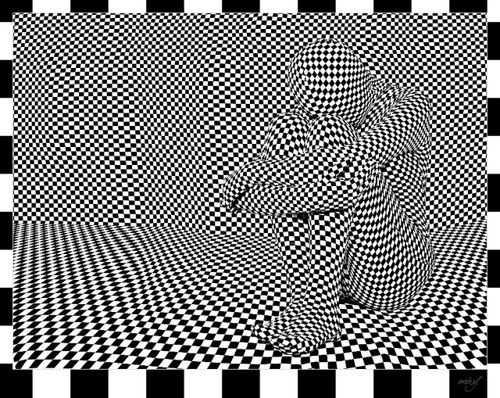

Slide 18
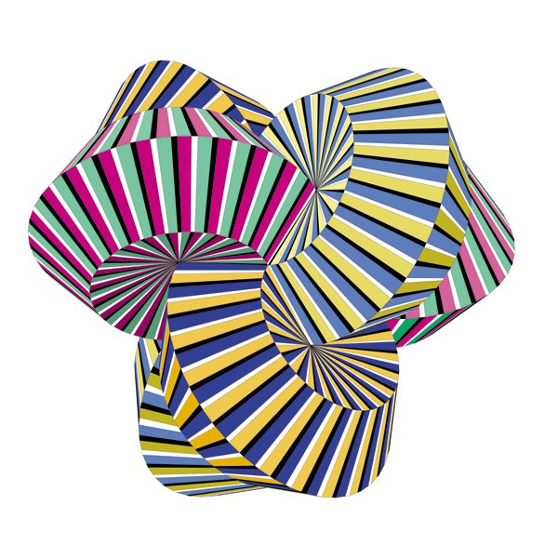

Slide 19
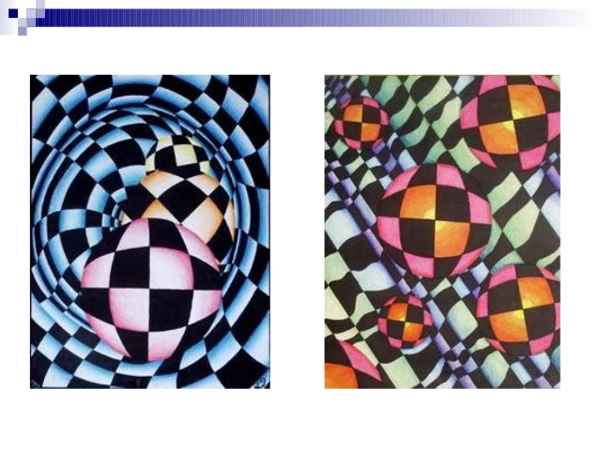

Slide 20
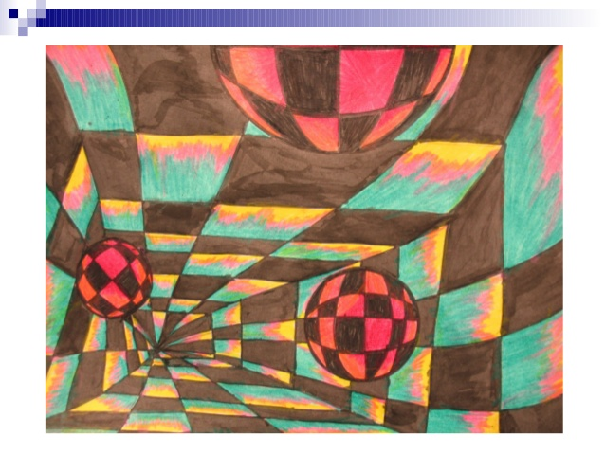

Slide 21
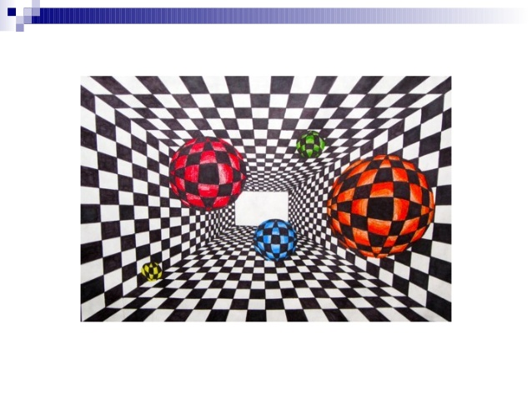

Slide 22
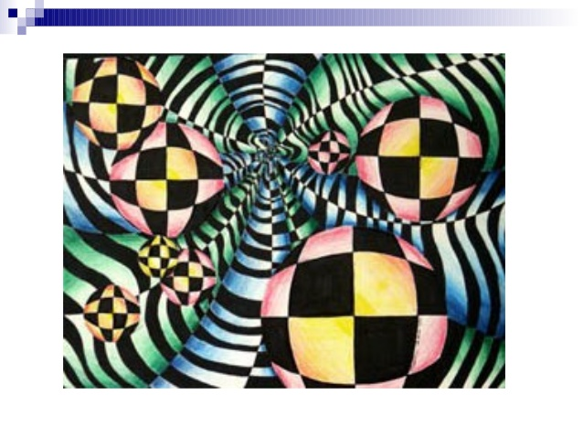

Slide 23
