Slide 1
Color theory
Color wheel and color theory terms

Slide 2
Color Wheel
an scientific way to organize color hues around a circle that shows relationships between primary colors, secondary colors, and tertiary colors

Slide 3
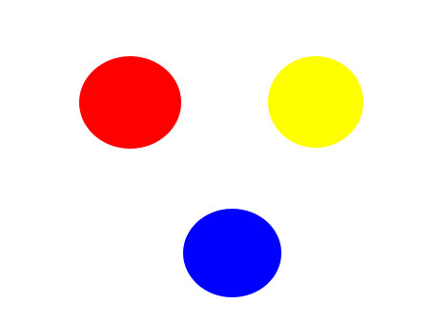
Primary Colors
Red, Yellow and Blue. Cannot be created by mixing any other colors.
They can be mixed to create EVERY other color

Slide 4
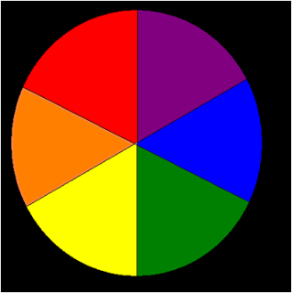
Secondary Colors
Green, Purple and Orange. Colors that are produced by mixing the primary colors.

Slide 5
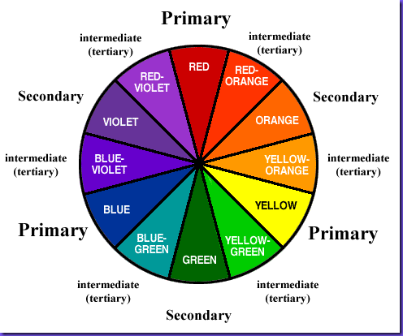
Tertiary Colors
Red-Orange, yellow-orange, Blue-Green and Yellow-Green, blue-violet and red-violet. Colors created by mixing a primary and secondary color

Slide 6
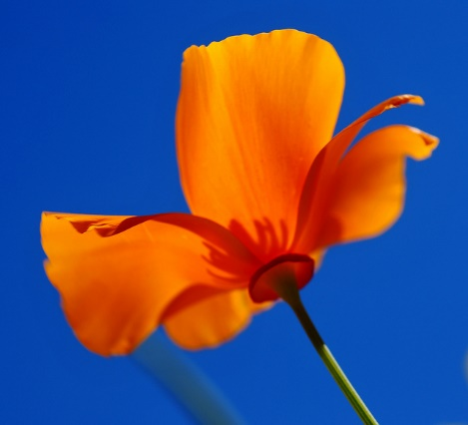
Contrast or Complimentary Colors
Colors Opposite Each Other on the color wheel

Slide 7
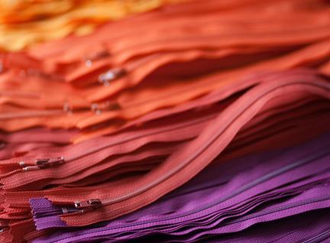
Analogous colors
2-3 colors side by side on a color wheel

Slide 8
Warm colors vs. cool colors

Slide 9
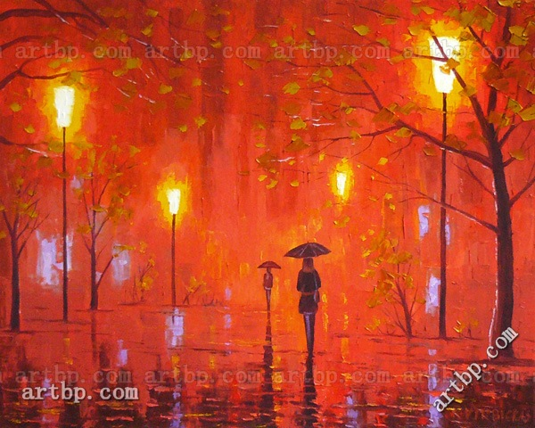
Warm Colors
Warm colors are said to advance or appear more active in a painting,
warm colors are said to arouse or stimulate the viewer,

Slide 10
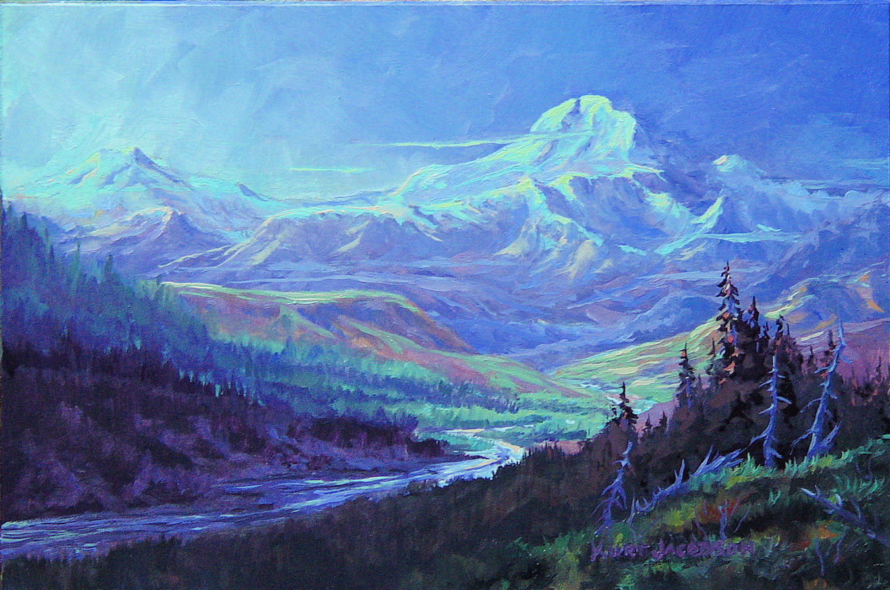
Cool Colors
cool colors tend to recede
cool colors calm and relax.

Slide 11
Tints and Shades
a tint is the mixture of a color with white
a shade is the mixture of a color with black,,

Slide 12
Hue, Value and Saturation/Intensity
Hue: The name of a color ( blue, green, etc)
Value: The lightness and darkness of a color
Saturation/Intensity: The vividness of a color. The POW or dullness of a color

