Slide 1
Copyright 101
What is it?
Why should I care?
Who owns the Copyright?
What is covered by Copyright? What isn’t?
What is Copyright infringement?
How do I avoid violating Copyright infringement?

Slide 2
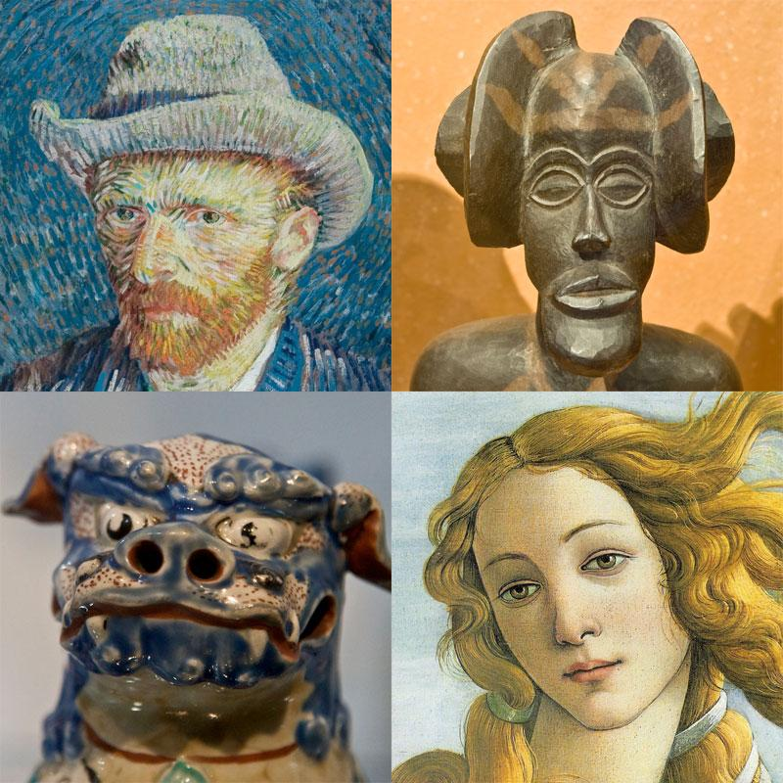
Copyright—What is it?
A form of protection given to the authors or creators of "original works of authorship," including literary, dramatic, musical, artistic and other intellectual works.
Creator has control over…
Making copies
Distributing copies
Performing publicly
Displaying publicly
Making ‘derivatives’

Slide 3
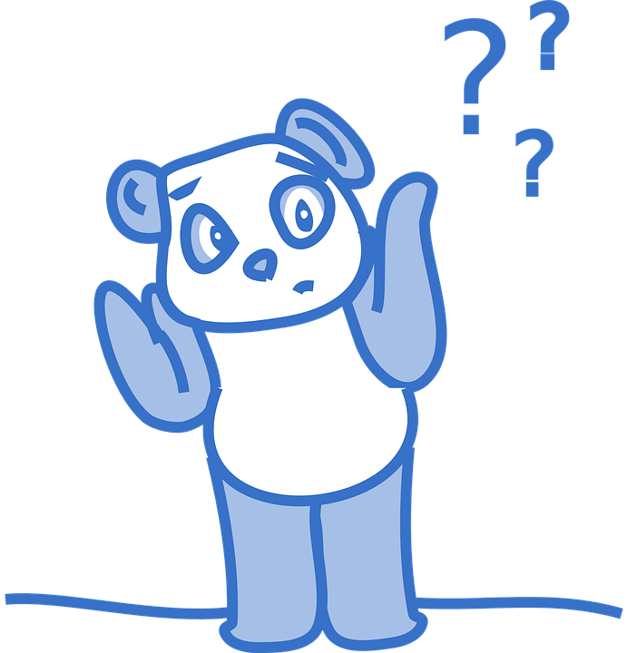
Why should I care?
Copyright law gives you a set of rights that prevents other people from copying your work and doing other things with your work that you may not like!
Reflects our appreciation for all the hard work that goes into creating "original works of authorship" and respect for the right of the creator of that work to control what people can and cannot do with it.

Slide 4
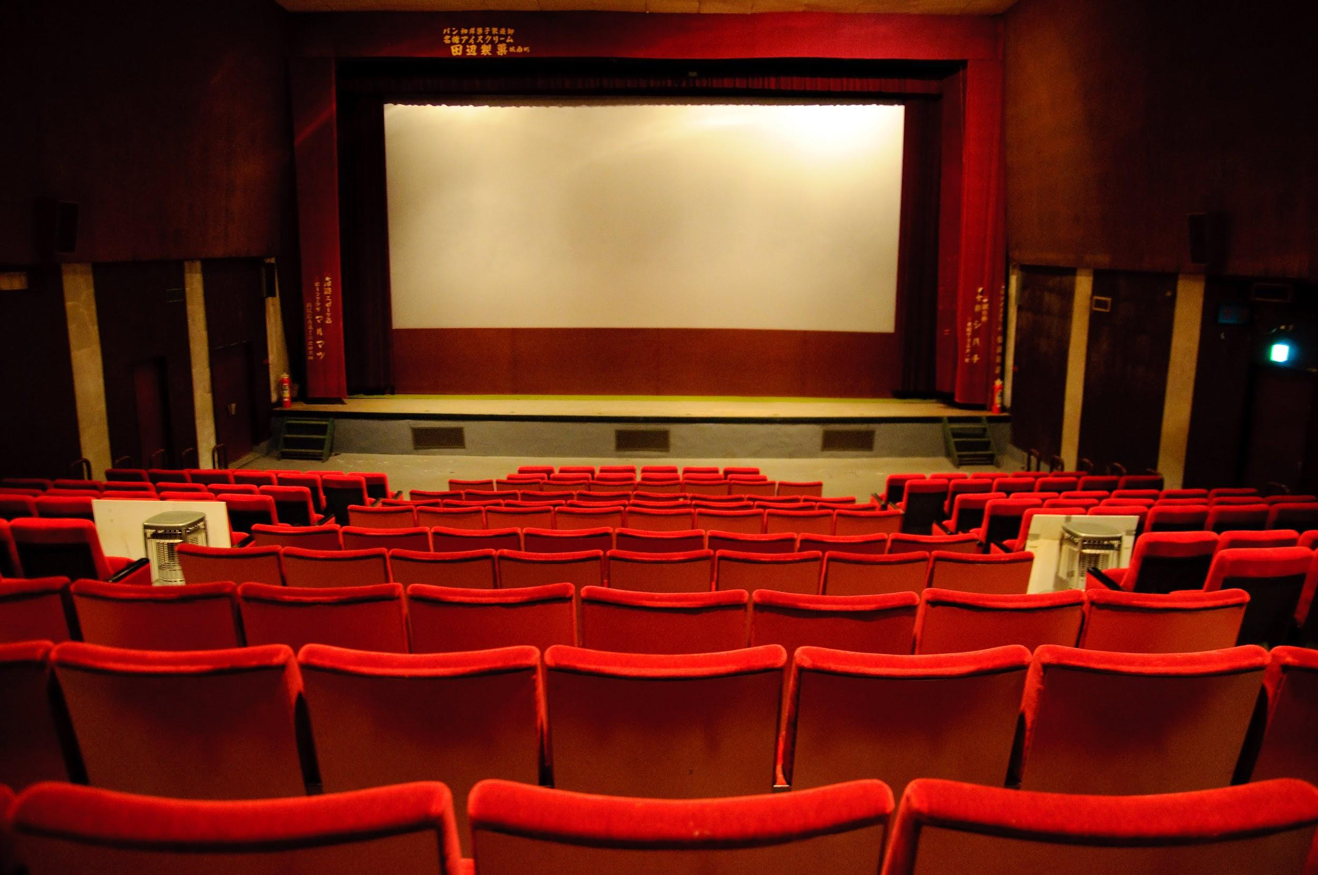
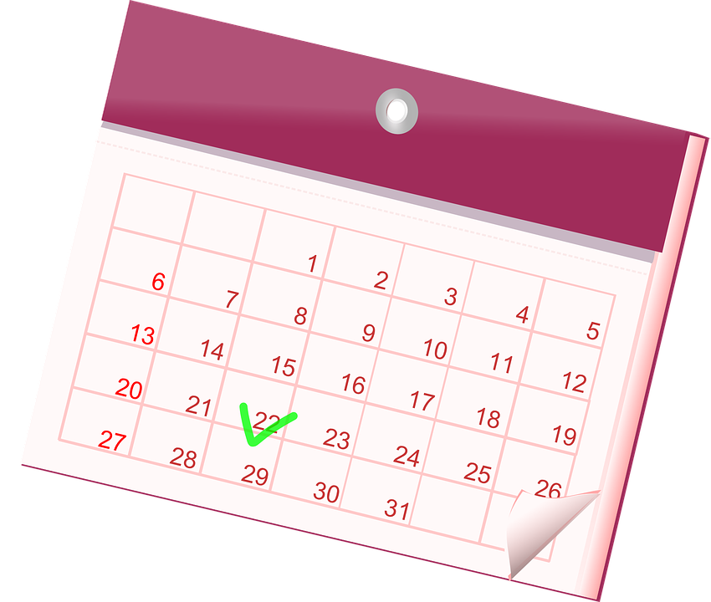
What is covered by Copyright?
What isn’t?
Ideas, procedures, methods, systems, processes, concepts, principles, discoveries, or devices
Titles, names, short phrases, and slogans
Works that are not fixed in a tangible form of expression (improv)
Works consisting entirely of information that is commonly available and contains no originality (calendars)
Works by US government
Literary works
Musical works
Dramatic works
Choreography
Pictorial, graphic, and sculptural works
Motion pictures
Sound recordings
Architectural works

Slide 5
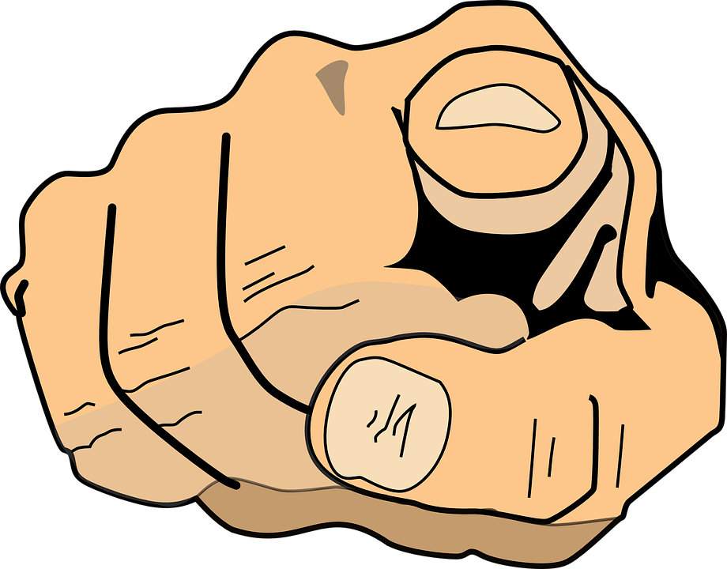
Who owns the Copyright?
The author who created it at the moment it is put into fixed form!!!!

Slide 6
What is Copyright infringement?
Violating the rights of the author…
Making copies
Distributing copies
Performing publicly
Displaying publicly
Making ‘derivatives’
...without their permission!

Slide 7
How do I avoid violating Copyright infringement?
The purpose behind your work:
Trying to sell? NOPE. Learning to use a grid to draw? YOU’RE SAFE.
Nature of the work:
Is it more factual, like a calendar?
The amount of work used:
Changing your image by 80%
Could the original author profited from your work? Not fair!

Slide 8
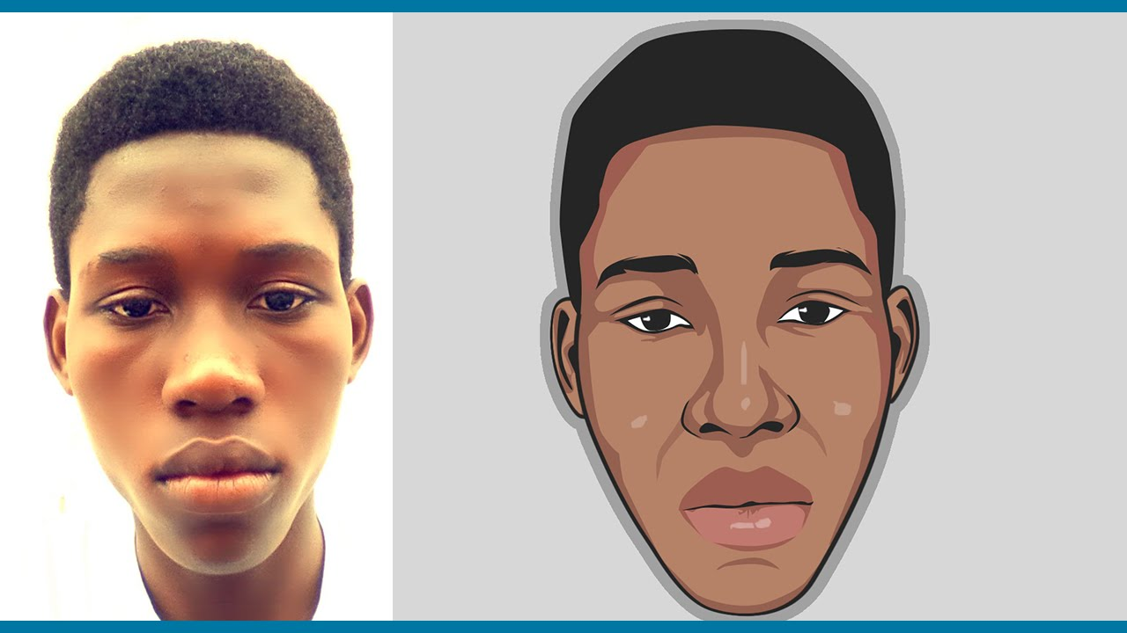
Choose a real-life PHOTOGRAPH
Change it to a CARTOON
Did NOT violate Copyright!

Slide 9
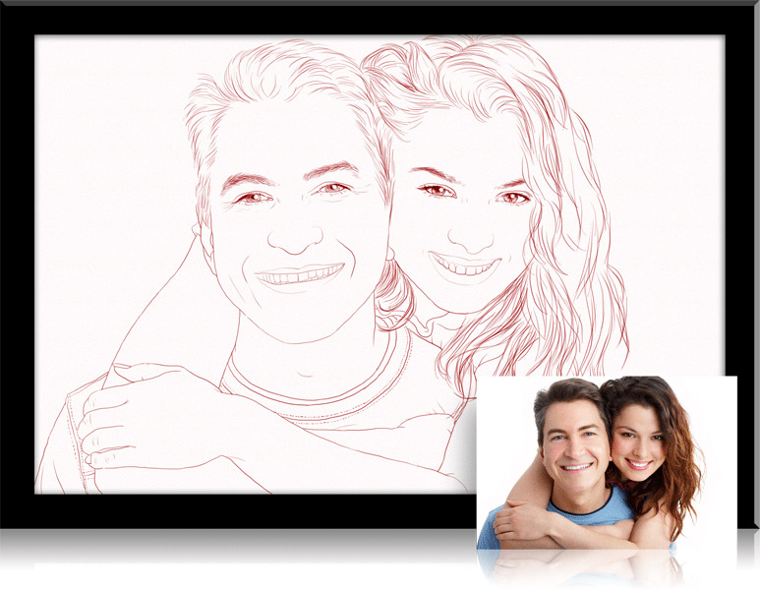
Choose a real-life PHOTOGRAPH
Change it to a CONTOUR LINE DRAWING
Did NOT violate Copyright!

Slide 10
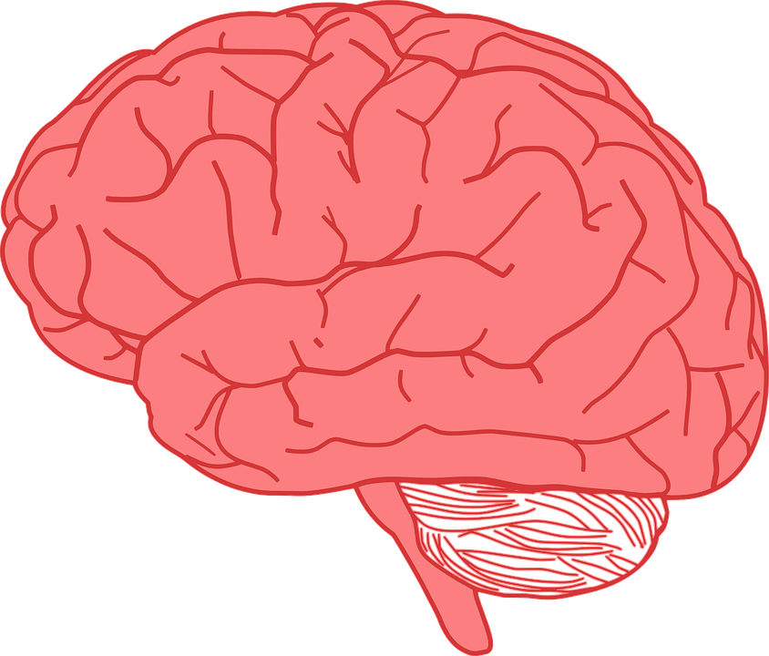

Slide 11
What is Copyright?

Slide 12
Why should you care?

Slide 13
What is Copyright infringement?

Slide 14
How can you avoid violating Copyright laws?

