Slide 1
Final Project Ideas

Slide 2
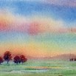
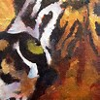
Create a watercolor landscape
Close up animal painting

Slide 3

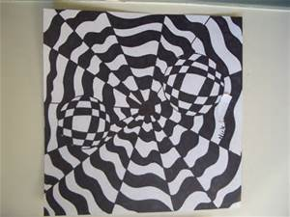
Create a portfolio of anime drawings
Create a piece of Op Art

Slide 4

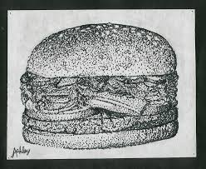
Draw an image using the pointillism method.
Do a grid drawing on a canvass and paint it

Slide 5
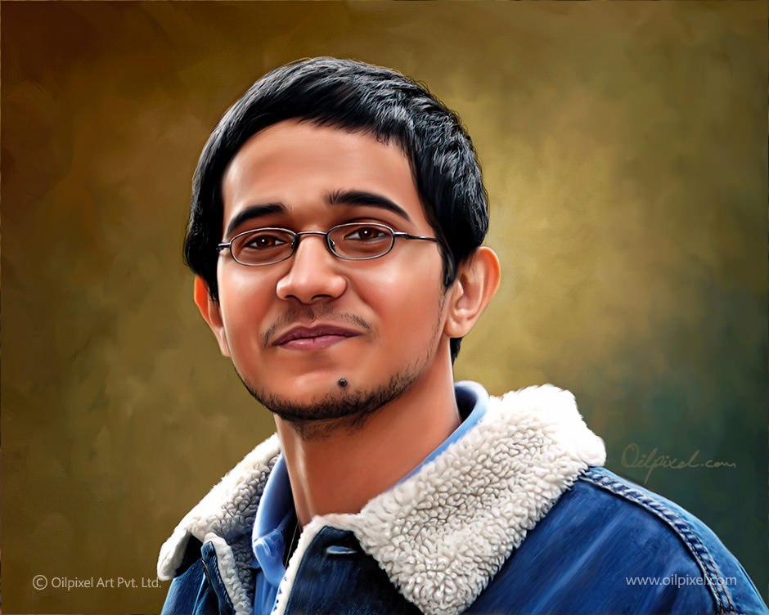
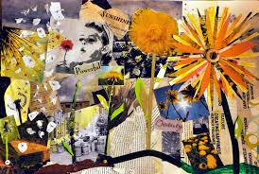
Draw/Paint a self-portrait using a grid
Choose a subject or idea and create a collage about it using principles of design

Slide 6
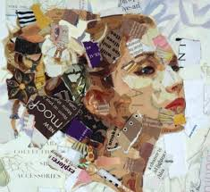
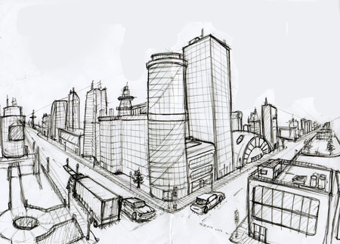
Self-portrait collage using different tones/colors found in magazines/newspaper/torn paper
Create a cityscape using 2 point perspective.

Slide 7
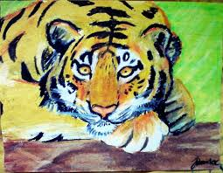
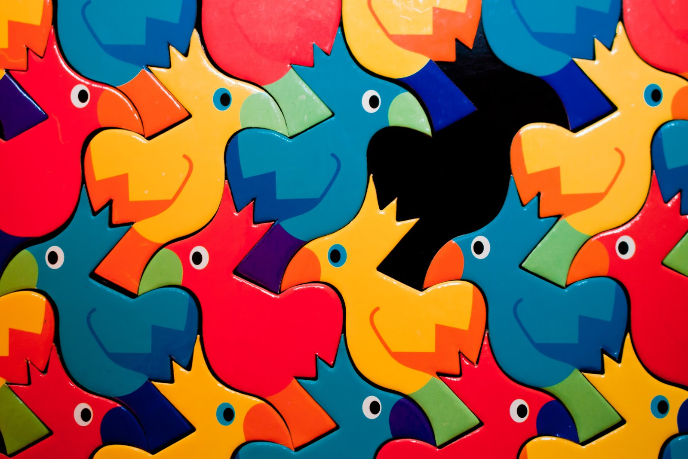
Draw an animal using oil pastels
Create a tessellation

Slide 8
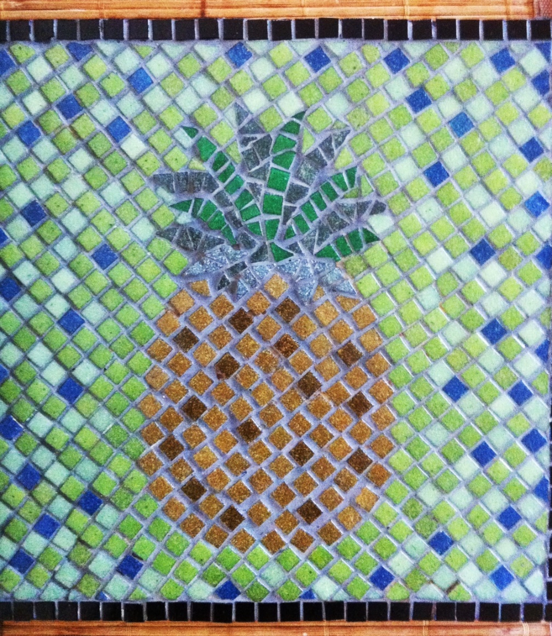
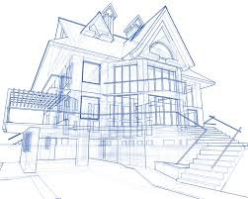
Create a mosaic
Architecture: design and draft either an exterior or interior of a house/building, etc.

Slide 9
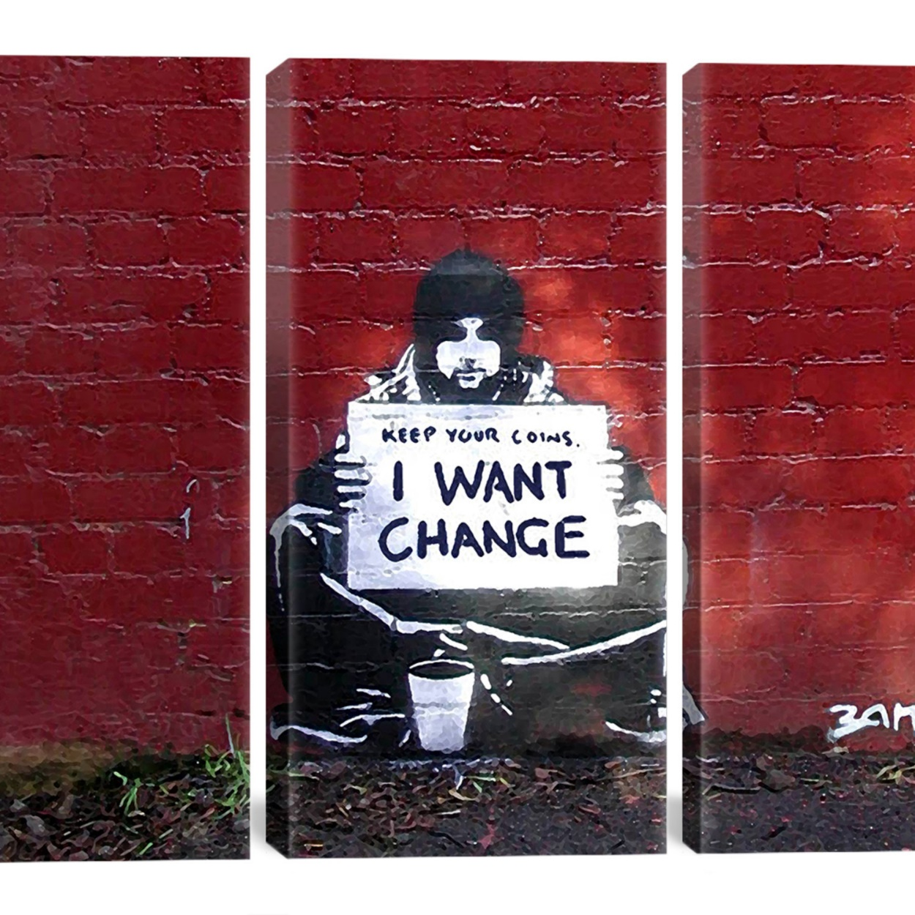
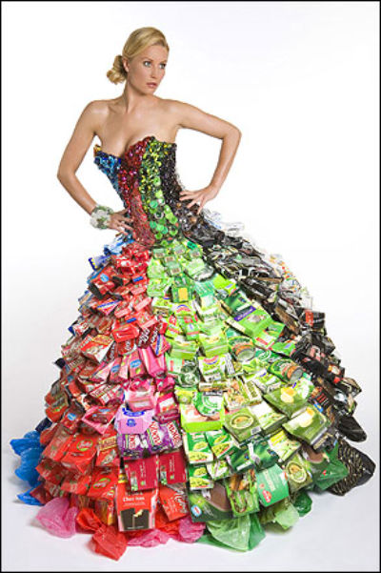
Create a piece of art based on a social or political issue
Fashion design using non-fabric materials

Slide 10
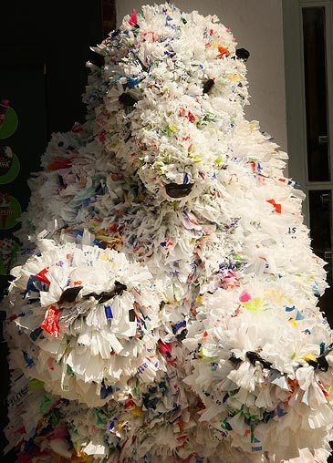
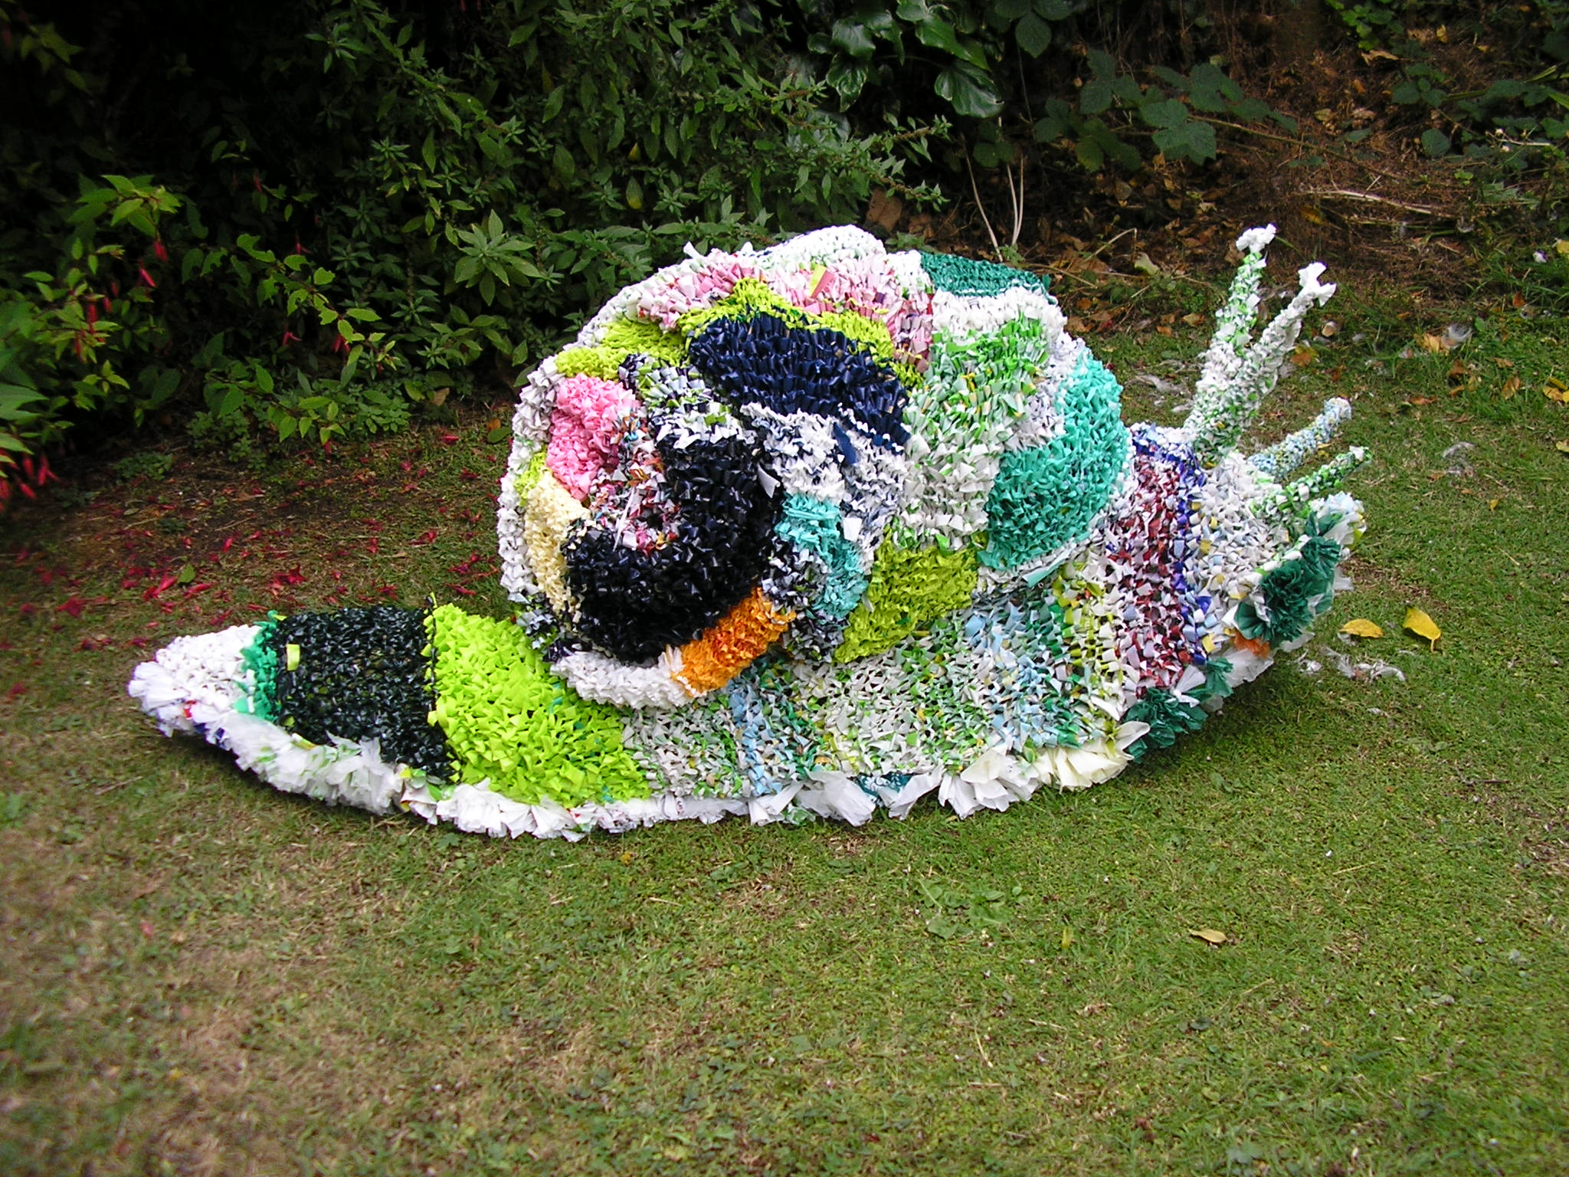
Create a sculpture using recycles materials

Slide 11
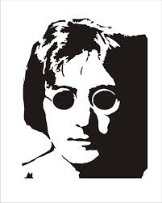
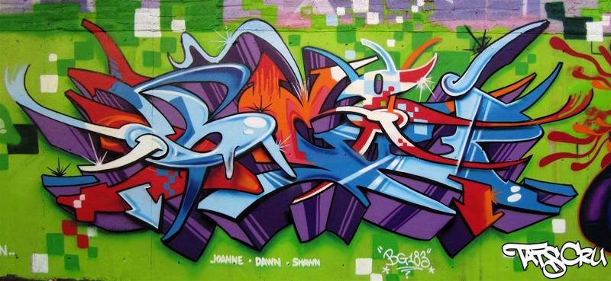
Graffiti art
Stencil art

Slide 12
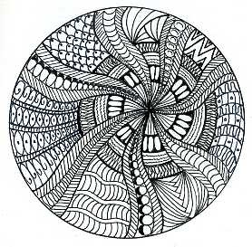
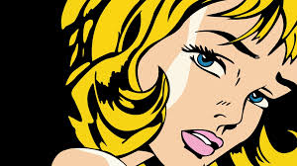
Pop art
Zentangles

Slide 13
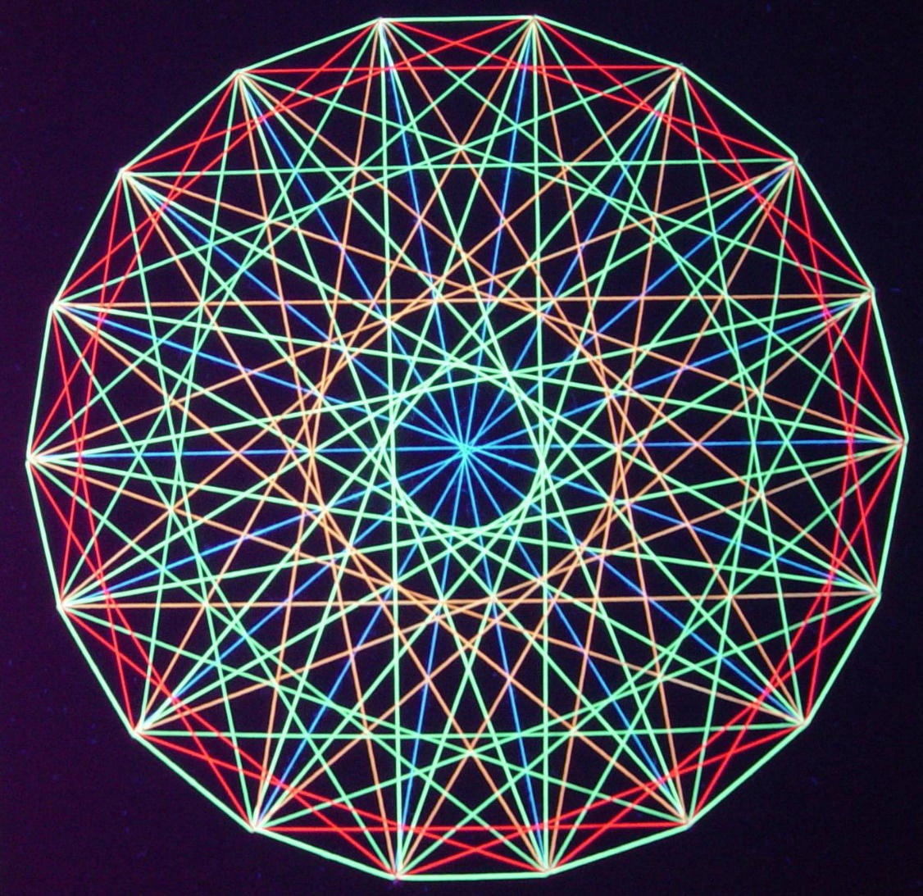
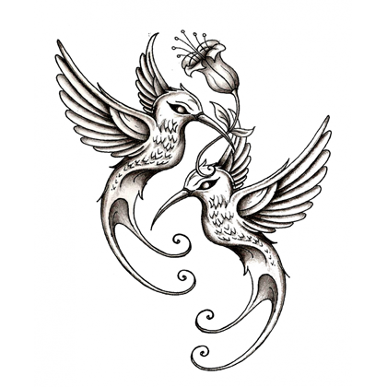
String art
Tattoo design

Slide 14
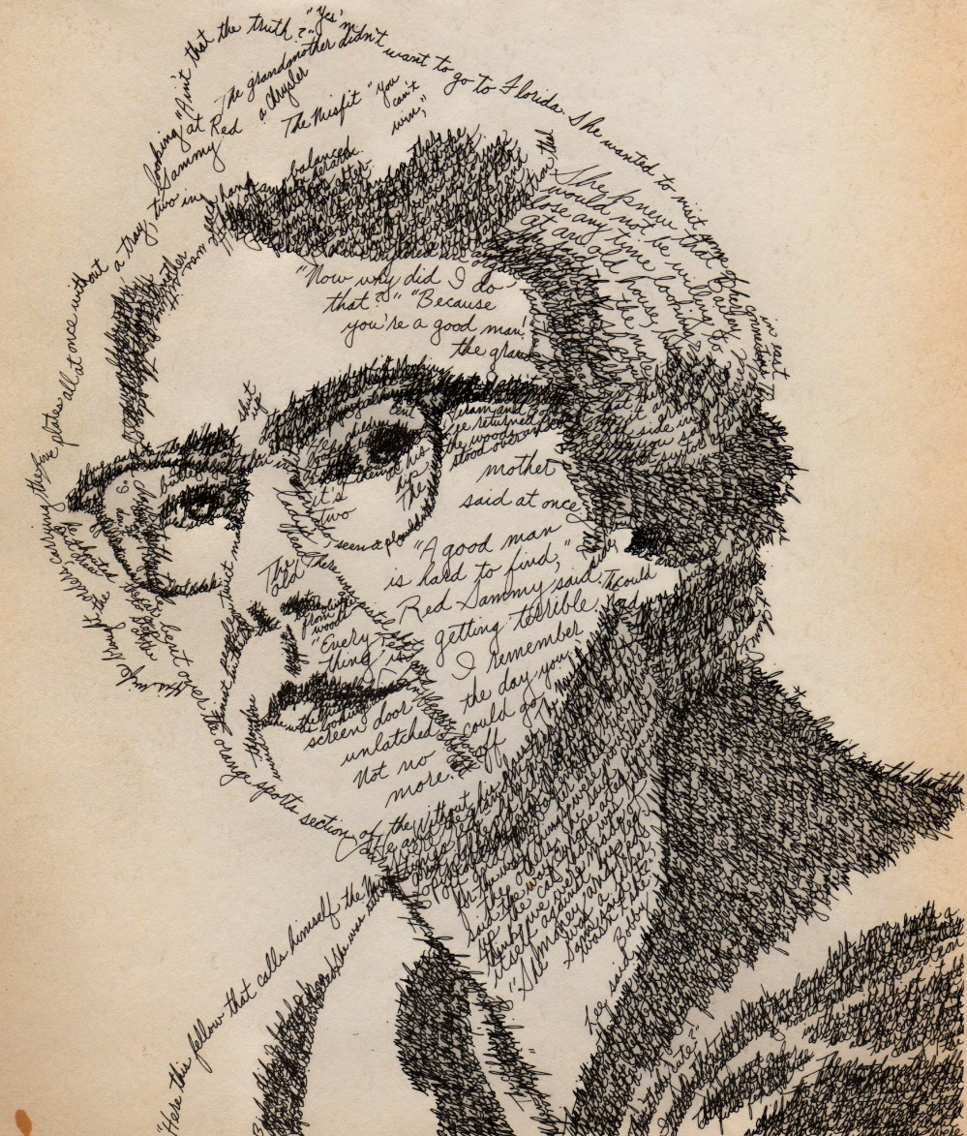
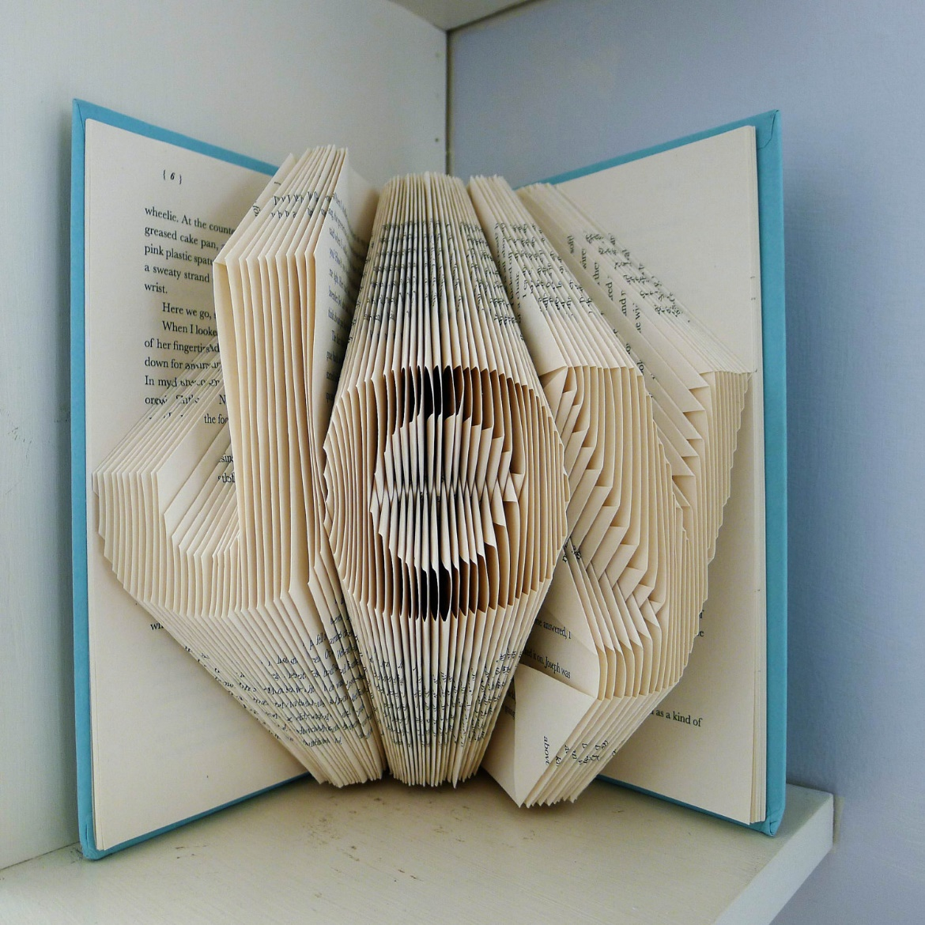
Word Art
Book art/book sculpture

Slide 15
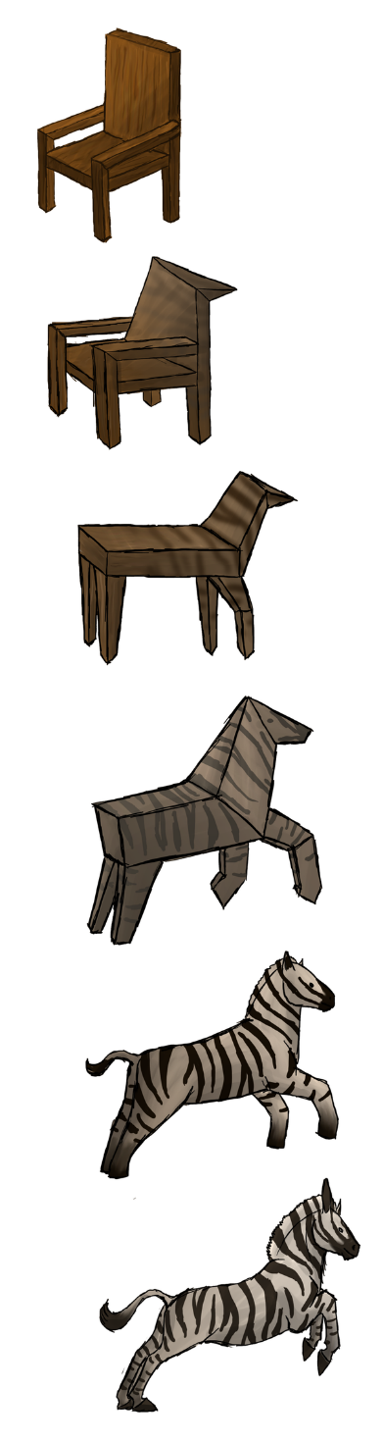
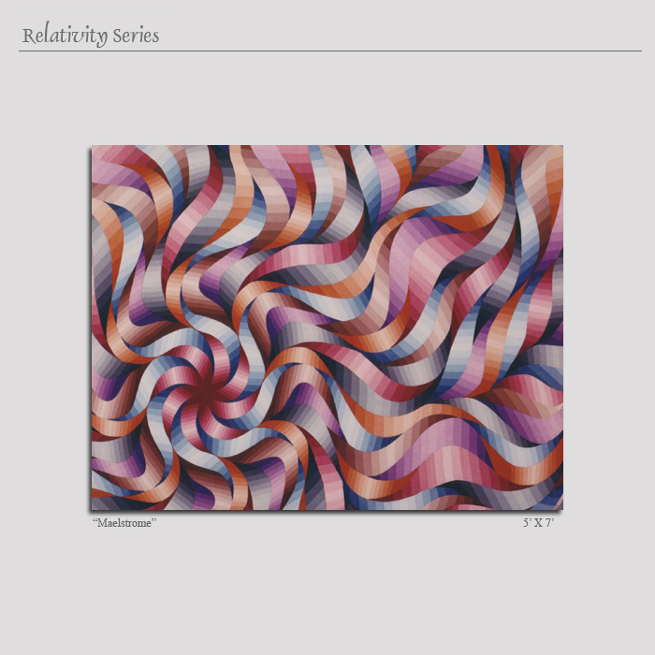
Geometric abstractions
Transformation drawings/paintings

Slide 16
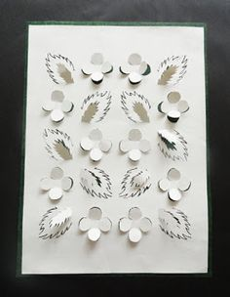
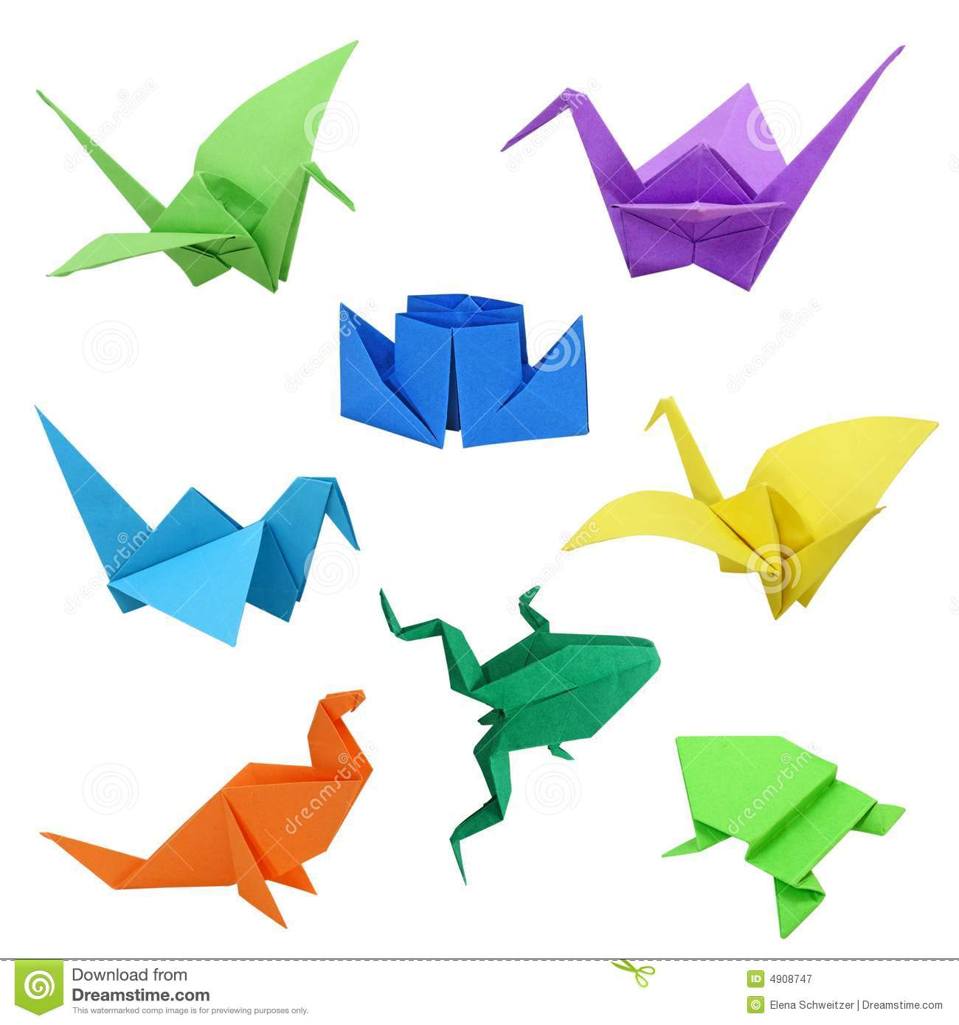
Create a paper relief sculpture
Learn and make a collection of origami

