Slide 1
Introduction to Grid

Slide 2
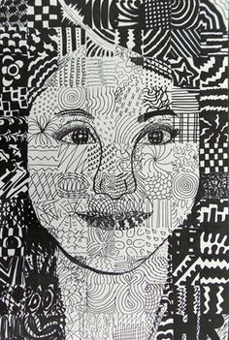

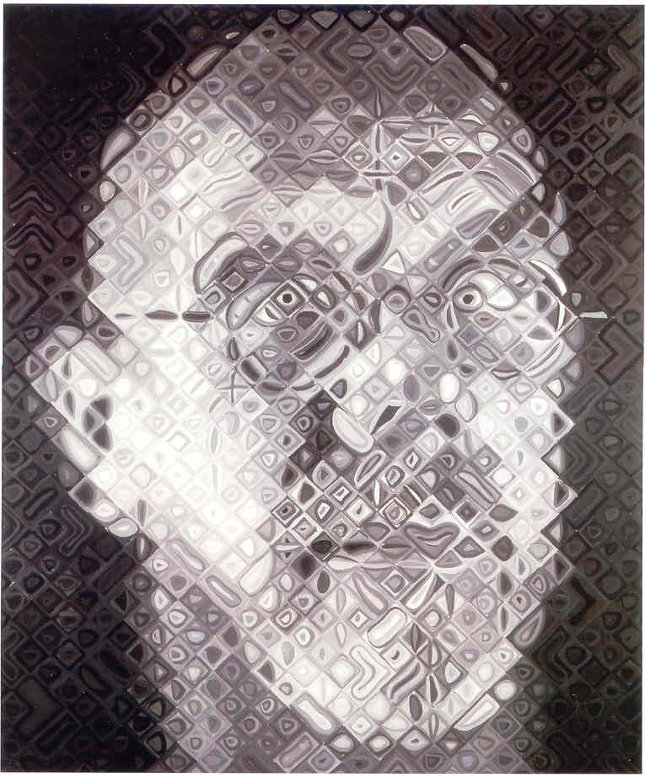
Chuck Close
Notes to younger self

Slide 3
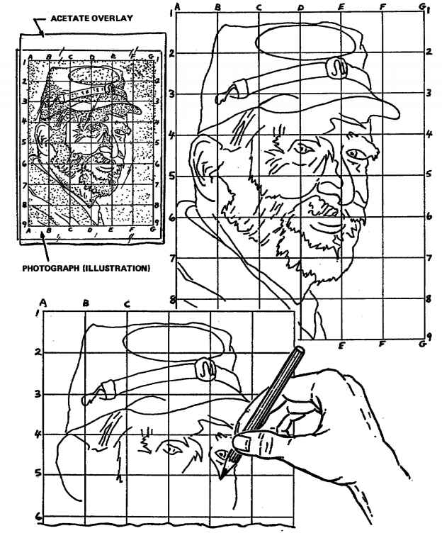
Benefits of Grid Drawing
Bite size pieces
Attention to details
Correct proportions
End results accurate
CONFIDENCE! :)

Slide 4
How to Draw Using A Grid
Draw square by square
Keep your gridded imaged and drawing closer together
Top left hand corner for righties, top right hand corner for lefties—prevent smudging
Judge where the line starts within the selected square by noting if it’s halfway down or at the top, etc.
Focus on the lines in that square ONLY

Slide 5
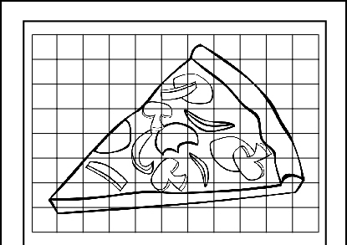

Slide 6
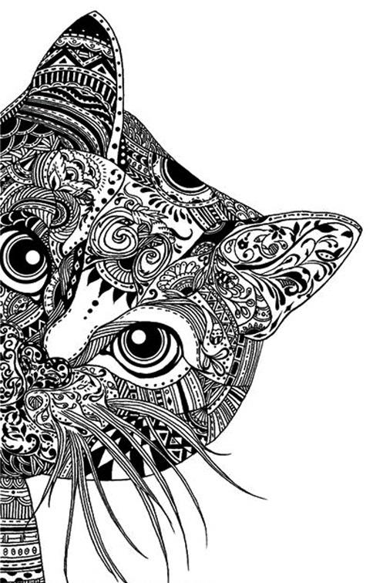
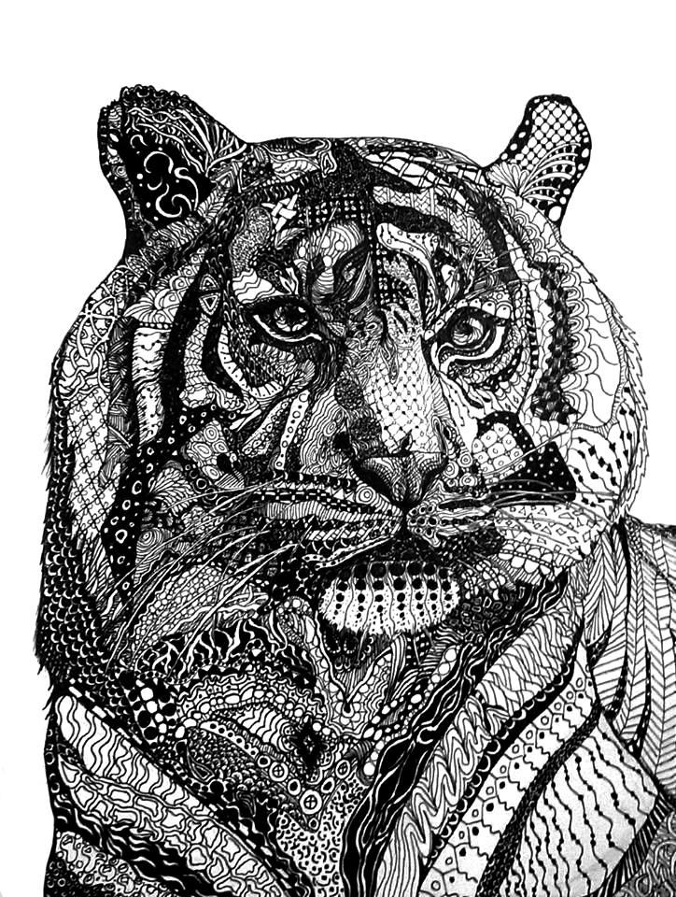

Slide 7
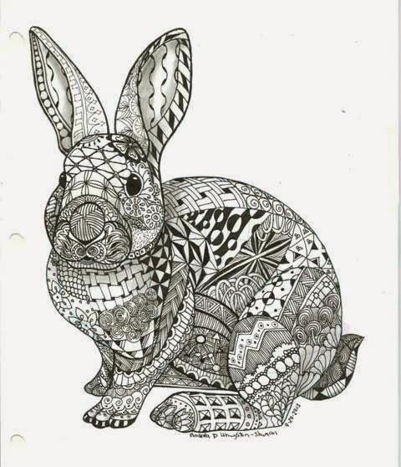
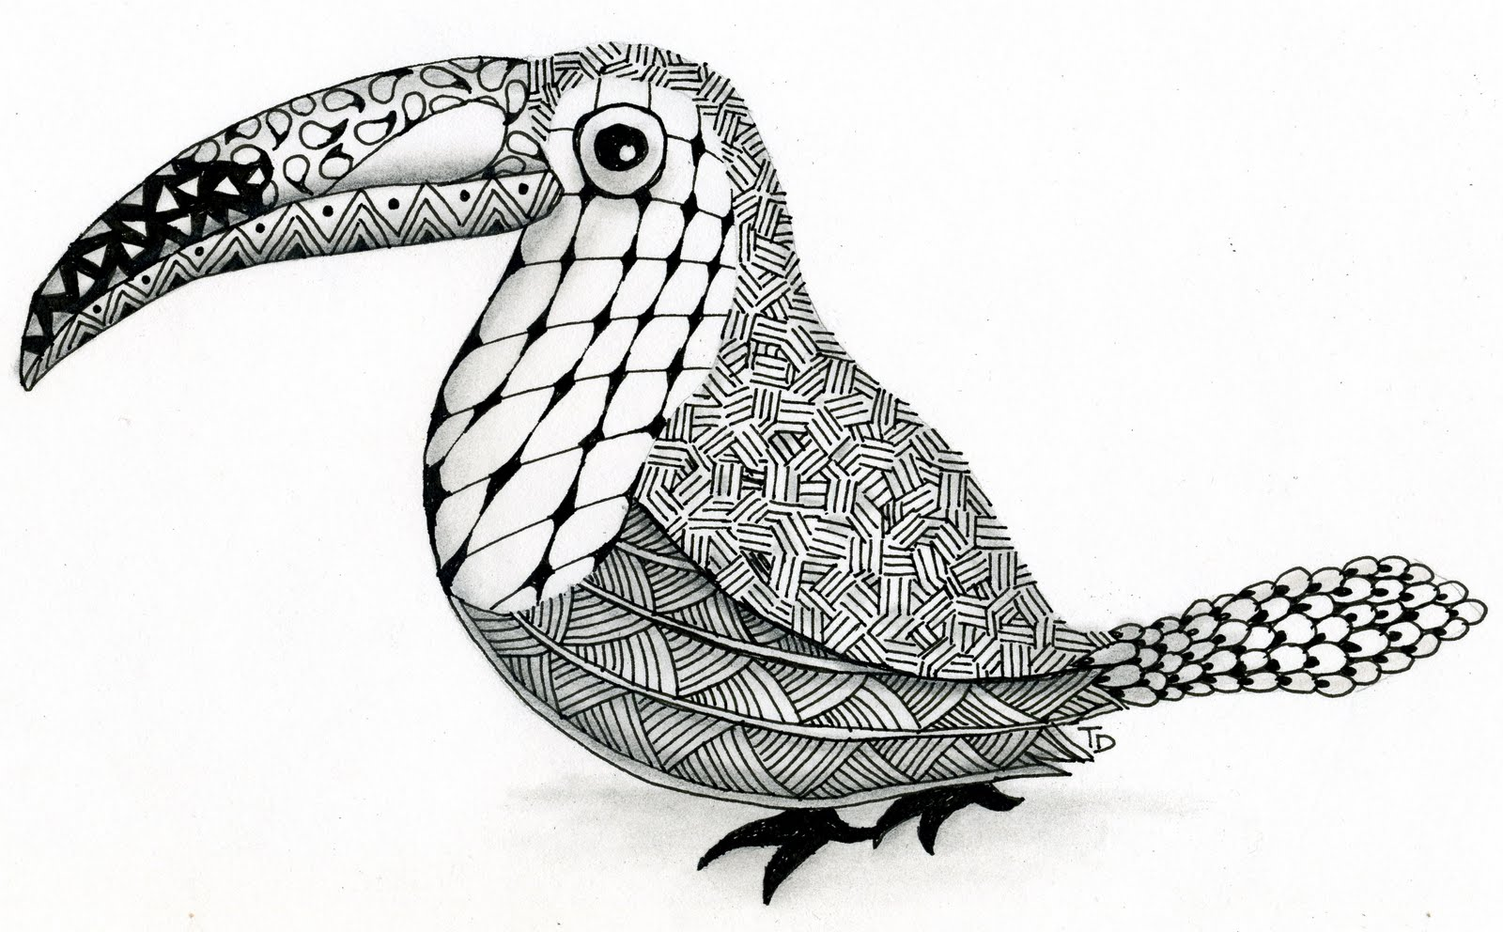

Slide 8


Slide 9
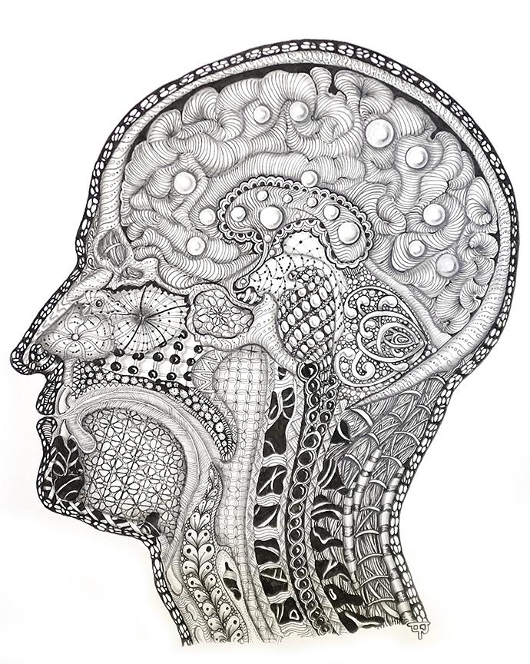
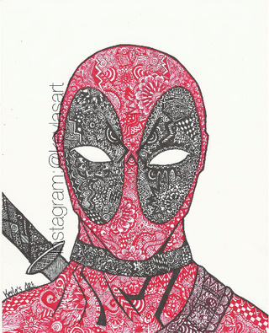

Slide 10
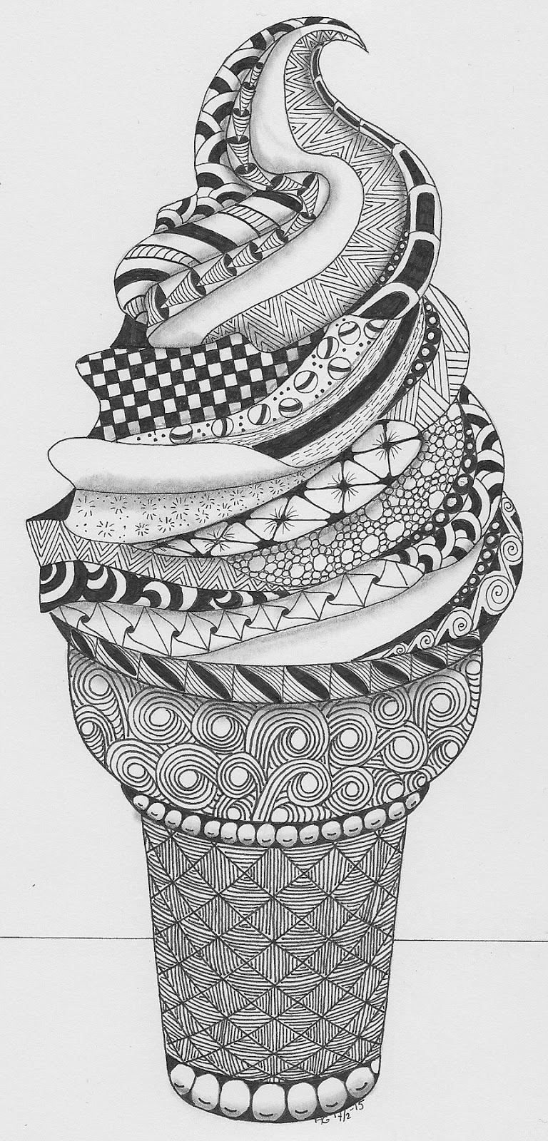

Want to work with typography?
Visit www.dafont.com!!!

Slide 11
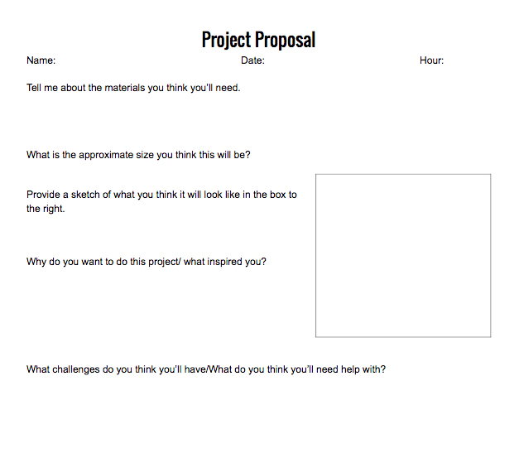
Project Proposal Form

Slide 12
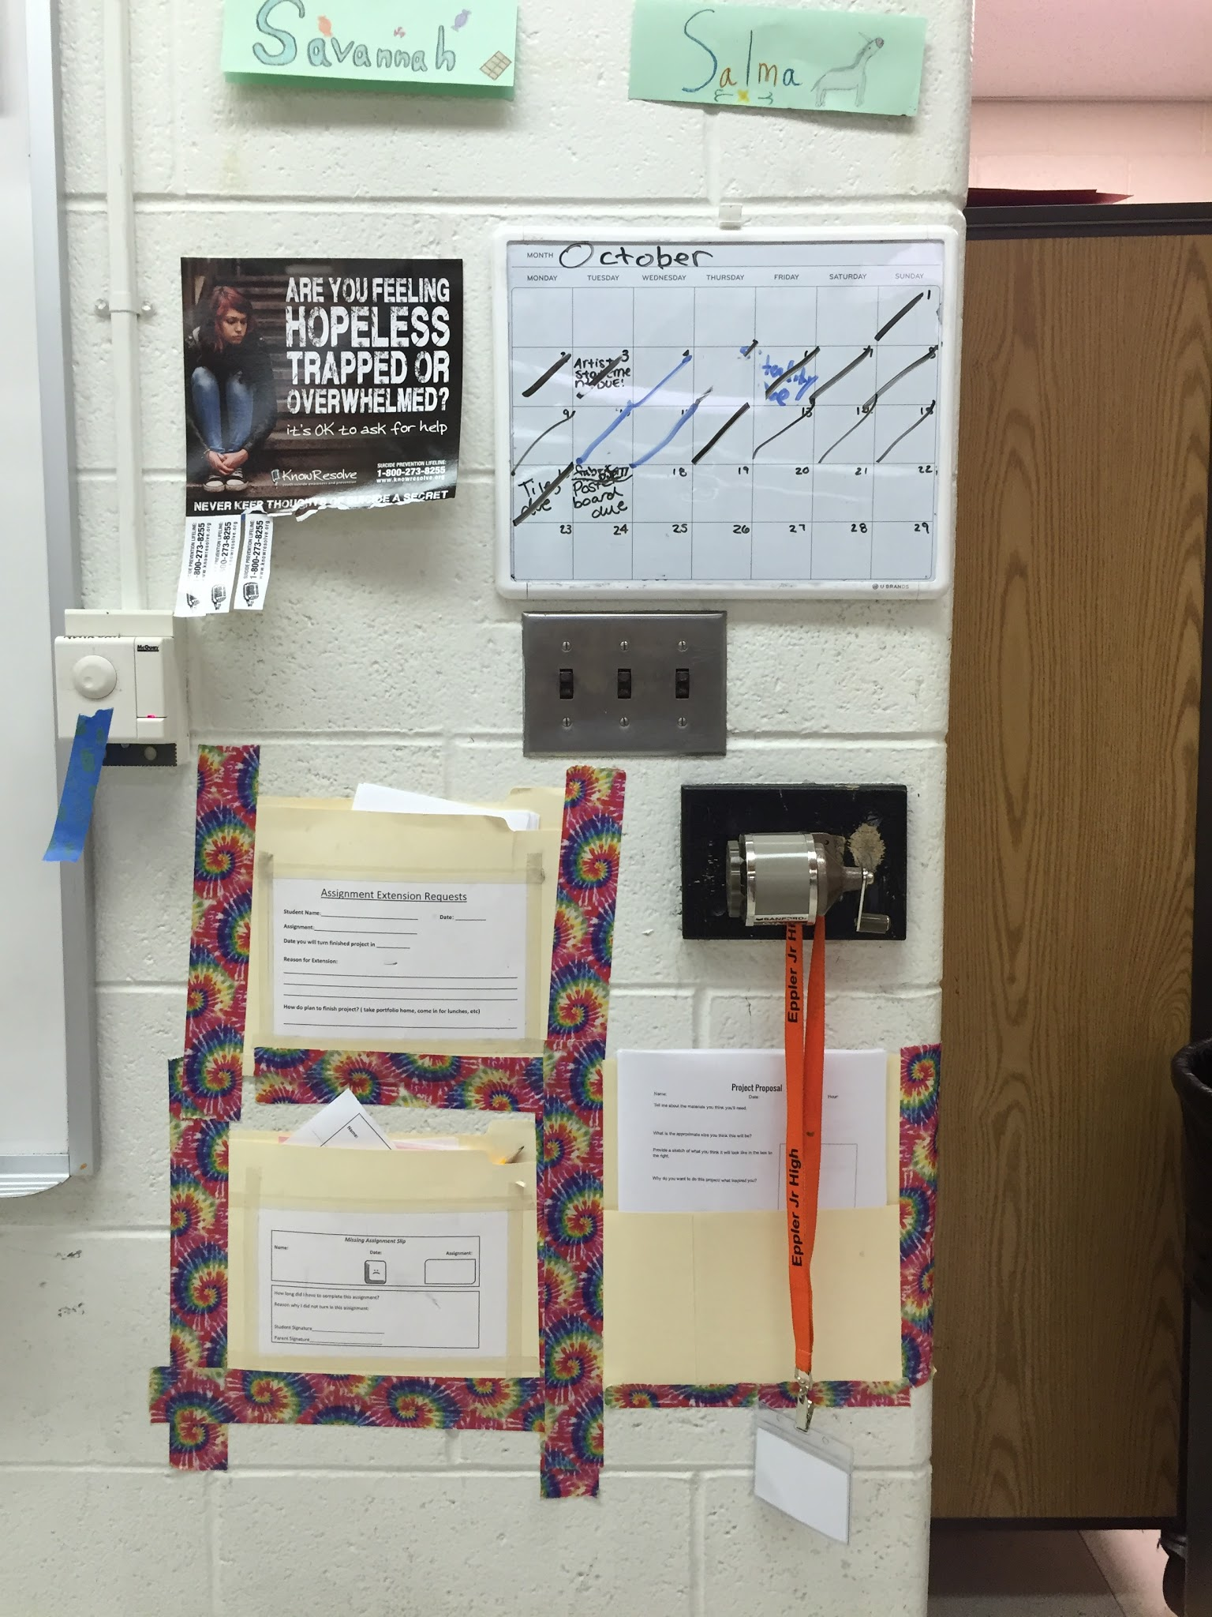
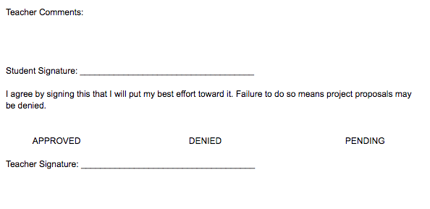
Project Proposal Form

Slide 13

STAND UP! :)
You already know….

