Slide 1
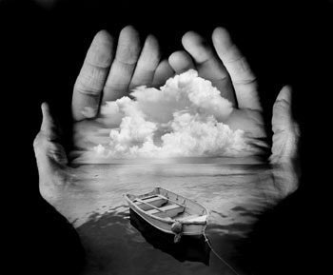
Surrealism

Slide 2
What is surrealism?
An artistic and literary movement
Began in 1924
Explored dreams, the unconscious and multiple levels of reality

Slide 3
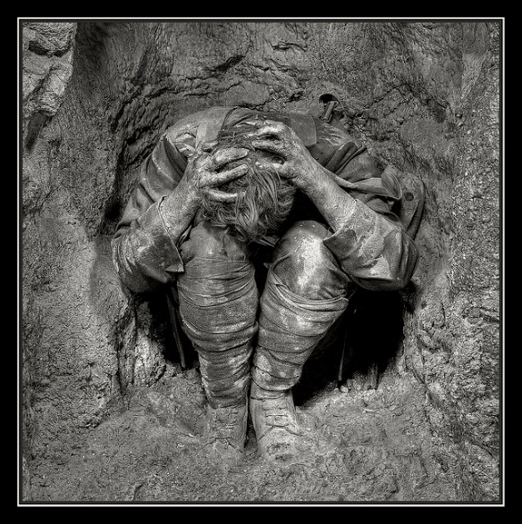
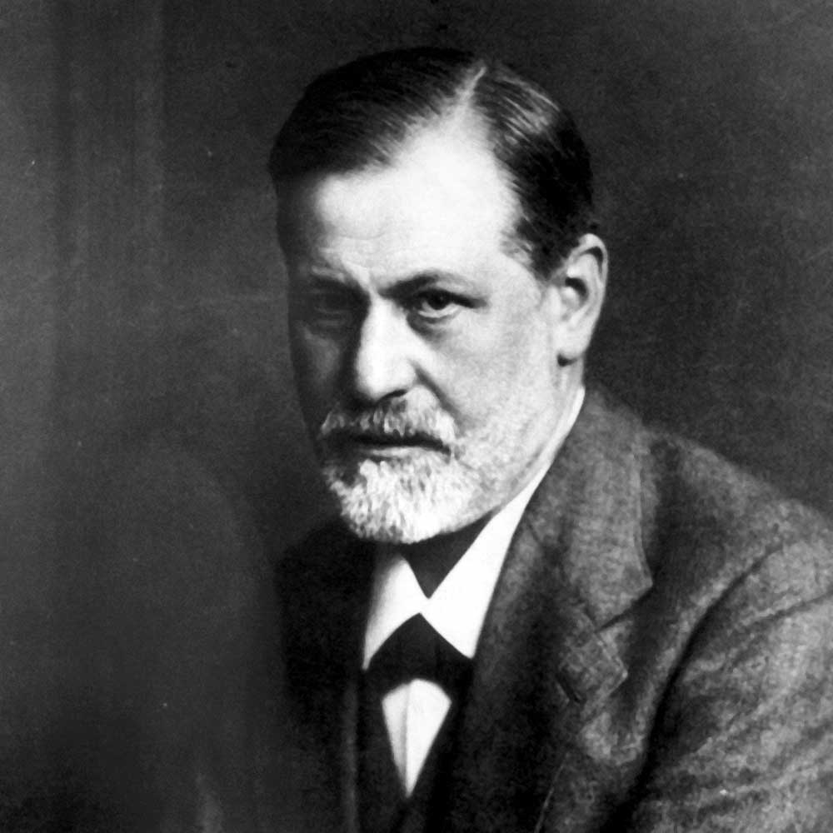
Why did Surrealism in 1924
What was happening in the world at this time?
World War I just ended
Sigmund Freud

Slide 4
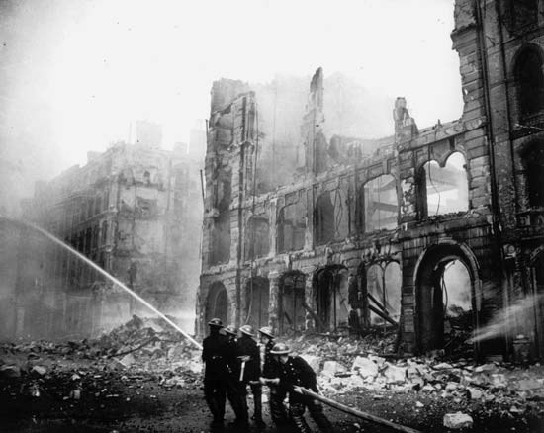
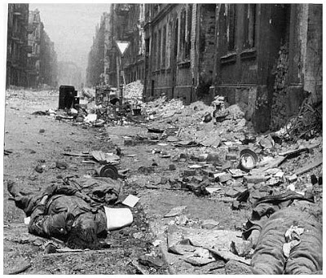
World War I physically and psychologically destroyed the Western World

Slide 5
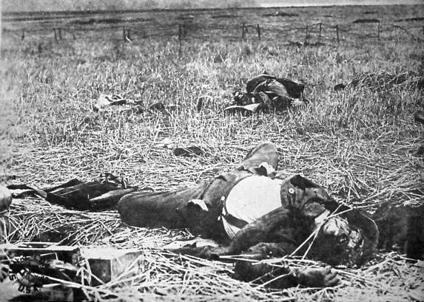
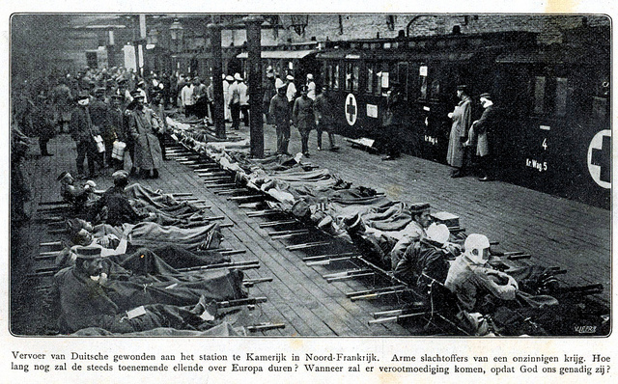
Staggering destruction and loss of life
Total causalities 11, 016, 000

Slide 6
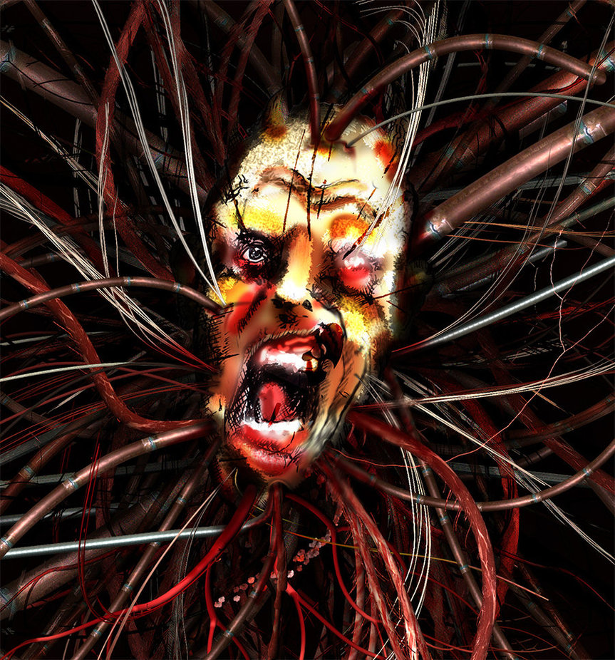
Sigmund Freud
In 1900 Freud published the interpretation of dreams
Introduced the world to the unconscious mind
“dreams are often most profound when they seem the most crazy”

Slide 7
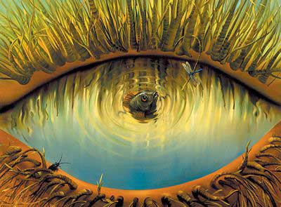
Surreal
Odd
Illogical
Irrational
Exciting
Disturbing

Slide 8
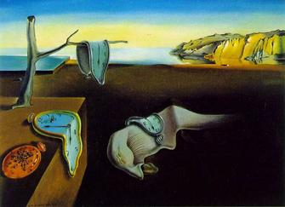
Characteristics of Surrealism
Reaction to Chaos of WWI
Influence of Freud, dreams and the subconscious
Impossible Scale
Reversal of natural laws
Double Images
Juxtaposition

Slide 9
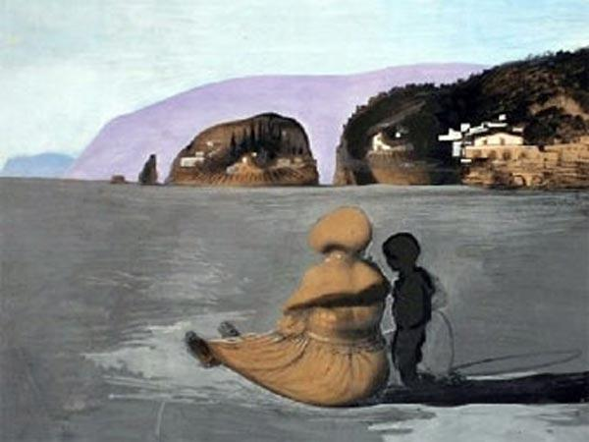
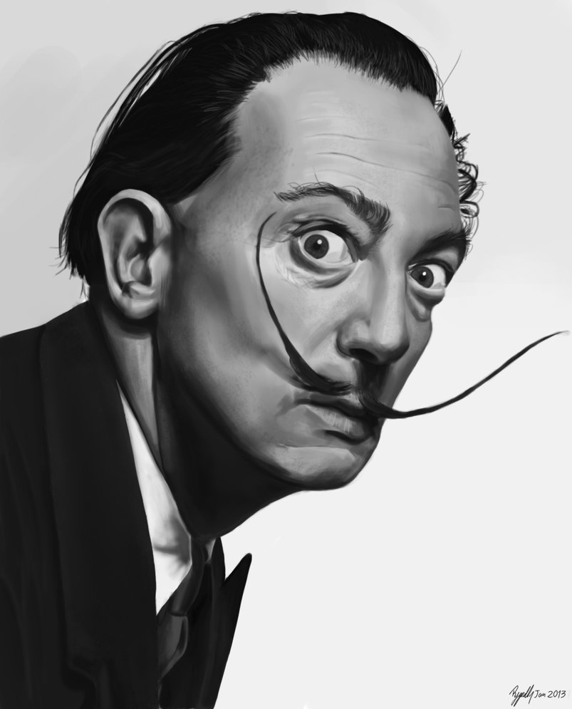
Salvador Dali
- Spanish

Slide 10
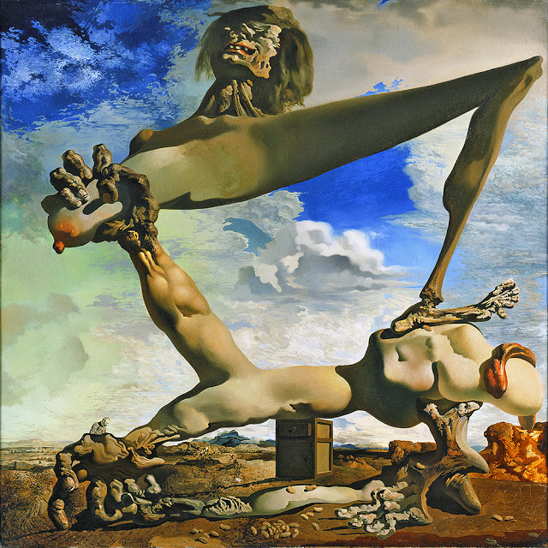
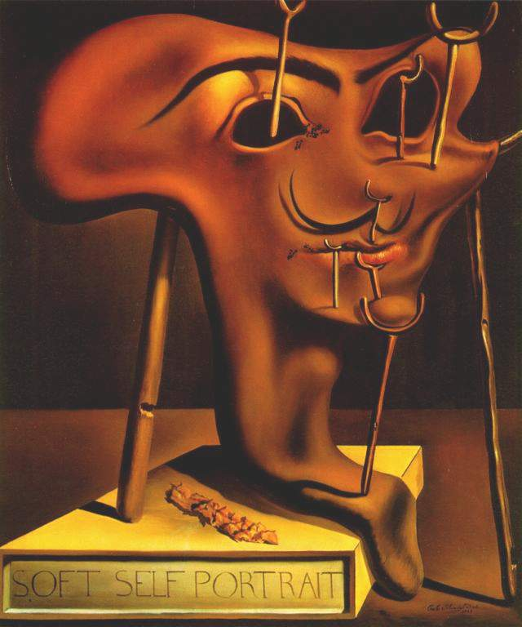
Dali cont…

Slide 11
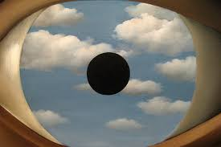
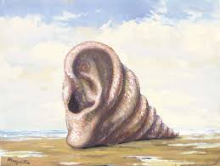
Rene Magritte
- France

Slide 12
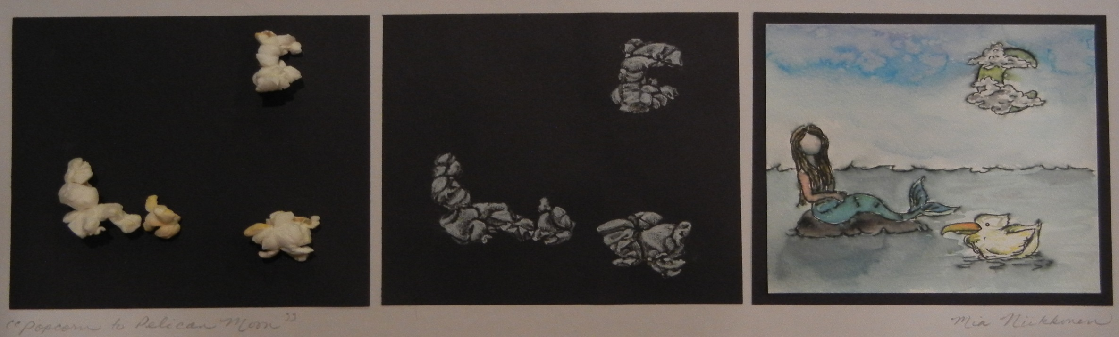
What does this mean for you?
In our next assignment we will be taking what we have learned from studying and drawing popcorn to transform what we “see” in our pop corn into a piece of art.

Slide 13
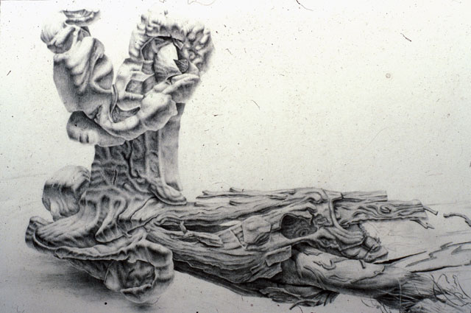

Slide 14
