Slide 1
The Elements of Art and Principles of design
Introduction to the basics of art and design

Slide 2
Introduction video
Watch these videos to get a basic understanding of the elements of art and principles of design.
https://youtu.be/qIOfbozTIY8
https://youtu.be/vCsXU_Zuum4
In your sketchbook, write down any words you knew prior to watching the video. For each of those words write a quick definition or draw a quick sketch to explain the term.

Slide 3
A more full description of the elements of art and principles of design
Watch the following video.
  Write down a definition for each of the elements of art and principles of design.
  We will be reflecting and having a discussion on how each of the elements and principles affect pieces of artwork.
  https://youtu.be/aRFTrCFOqNo

Slide 4
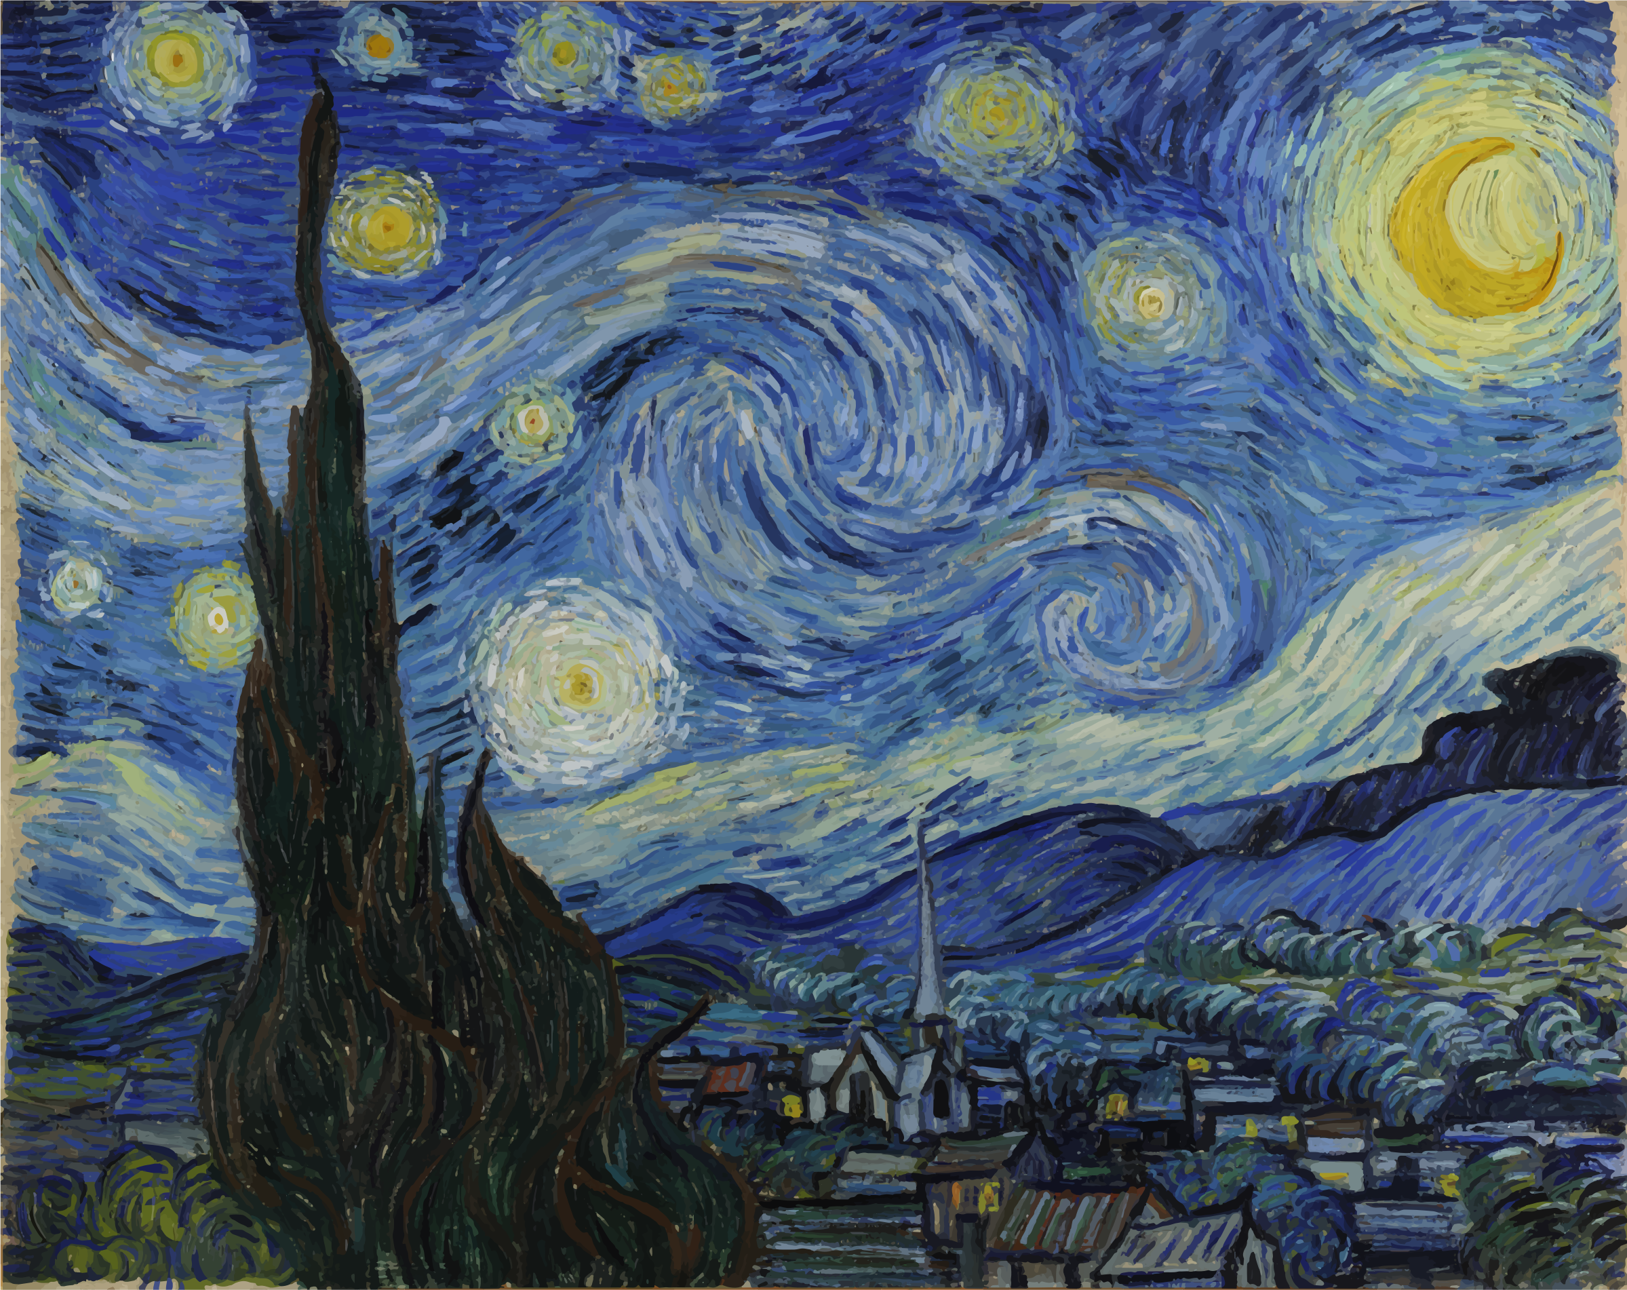
Work with a partner to create a full analysis of how EVERY element of art and principle of design Affects the painting below

