Slide 1
Value Portraits
Monochromatic Painting

Slide 2
Terms
Portrait
A drawing, painting or photograph of a person
Monochromatic
Different values of the same hue
Hue:
The name of a color (blue, green, red, macaroni and cheese, etc)
Value:
The lightness and darkness of a color
Value Scale:
A tool artists create and use to see the range of values in a particular hue (color)
Abstract:
not realistic
Tint:
adding white to a hue (color)
Shade:
Adding black to a hue (color)

Slide 3
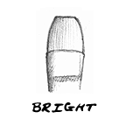
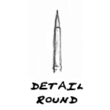
Types of brushes
Square end, with medium to long hairs.
Good for: bold strokes, washes, filling wide spaces, impasto. can use edge for fine lines, straight edges and stripes. long haired flat brushes are ideal for varnishing.
Flat with edges curved inward at tip, with shortish hairs.
Good for: short controlled strokes. thick, heavy color. better for working up close rather than holding the brush at a distance from the canvas.
Round, hairs shorter in length. shorter handle.
Good for: details and short strokes. holds more color than you might think!

Slide 4
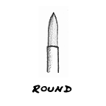
Flat with angled hairs at end. Good f or: curved strokes and filling corners. can reach small areas with tip. also can be used to cover lots of space, similar to flat brushes.
Round or pointed tip.
Good for: sketching, outlining, detailed work, controlled washes, filling in small areas. creates thin to thick lines - thin at the tip, becoming wider the more its pressed down.. use with thinned paint rather than thick paint

Slide 5
Narrower than the round paintbrush. has sharply pointed tip.
Good for: fine details and lines, delicate areas, spotting and retouching.
Acrylic Paint: plastic based
Tempera Paint: Chalky, egg based paint that is water soluble
Canvass: Cloth surface acrylic and oil pain is applied to

Slide 6
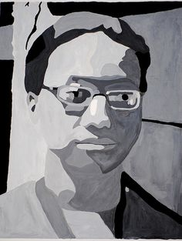
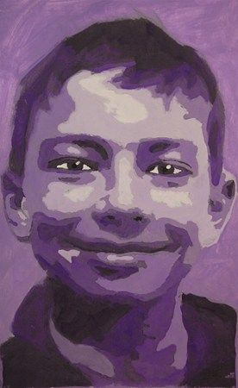

Slide 7
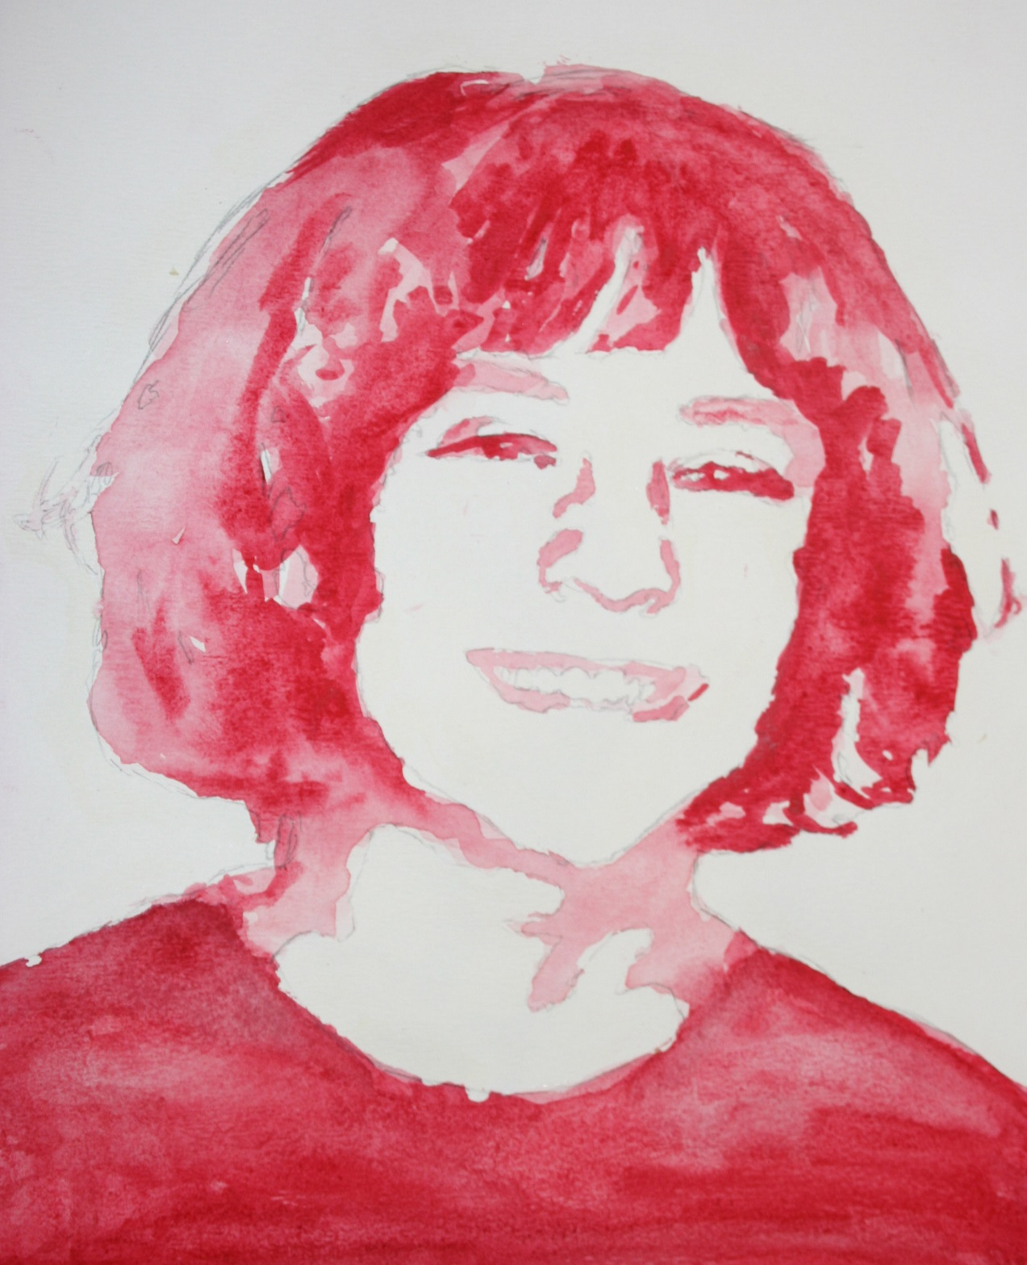
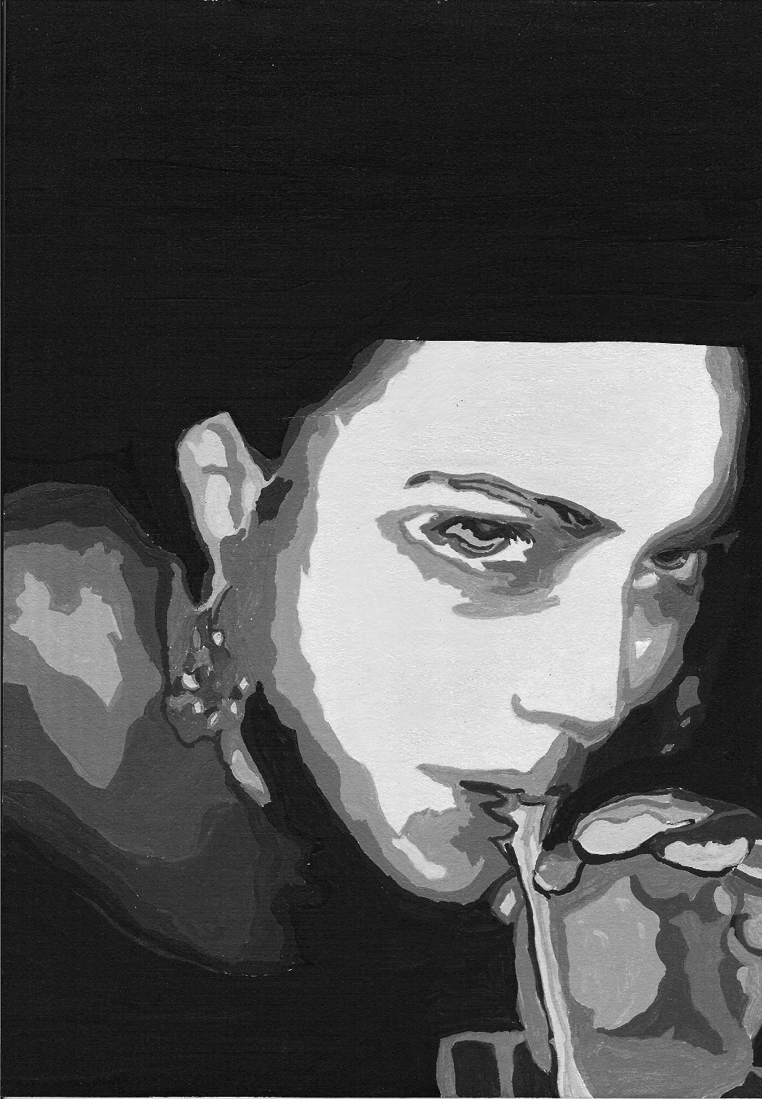

Slide 8
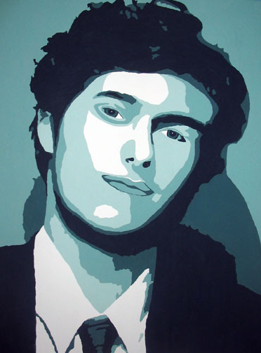
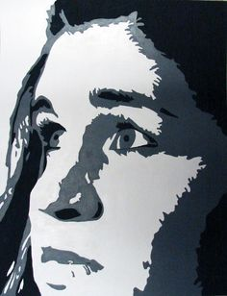

Slide 9
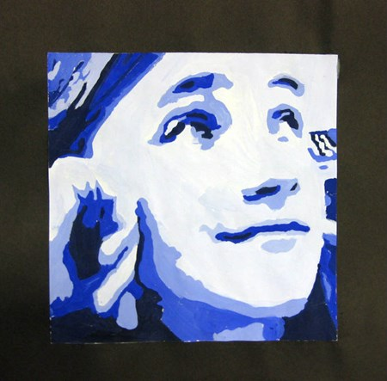

Slide 10
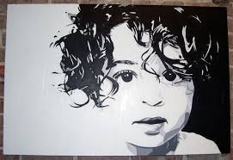

Slide 11
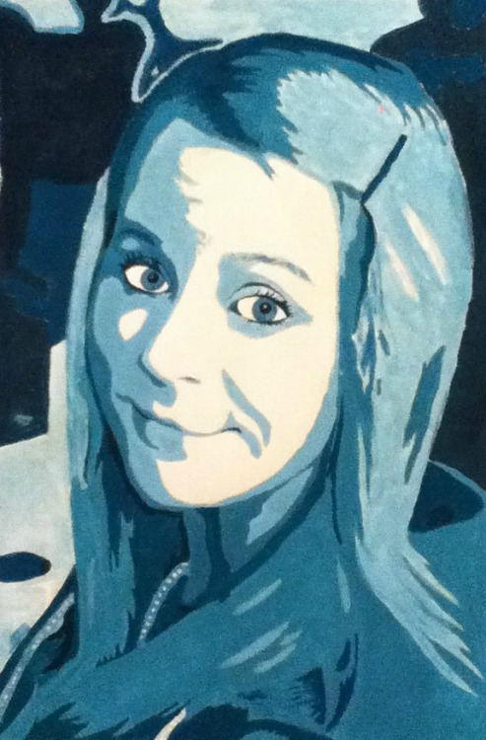
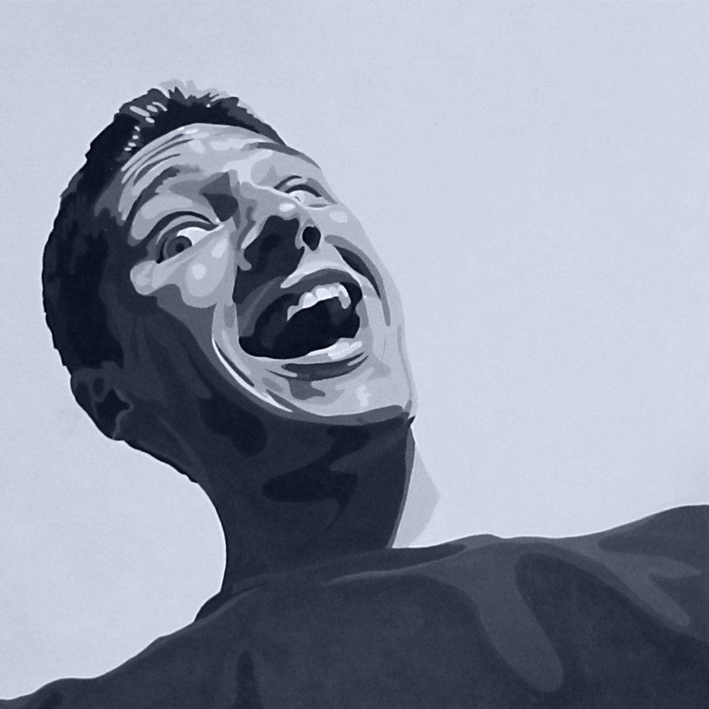

Slide 12
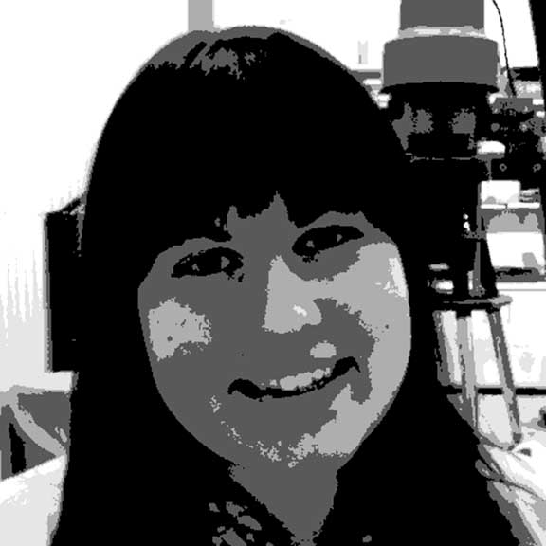

Slide 13
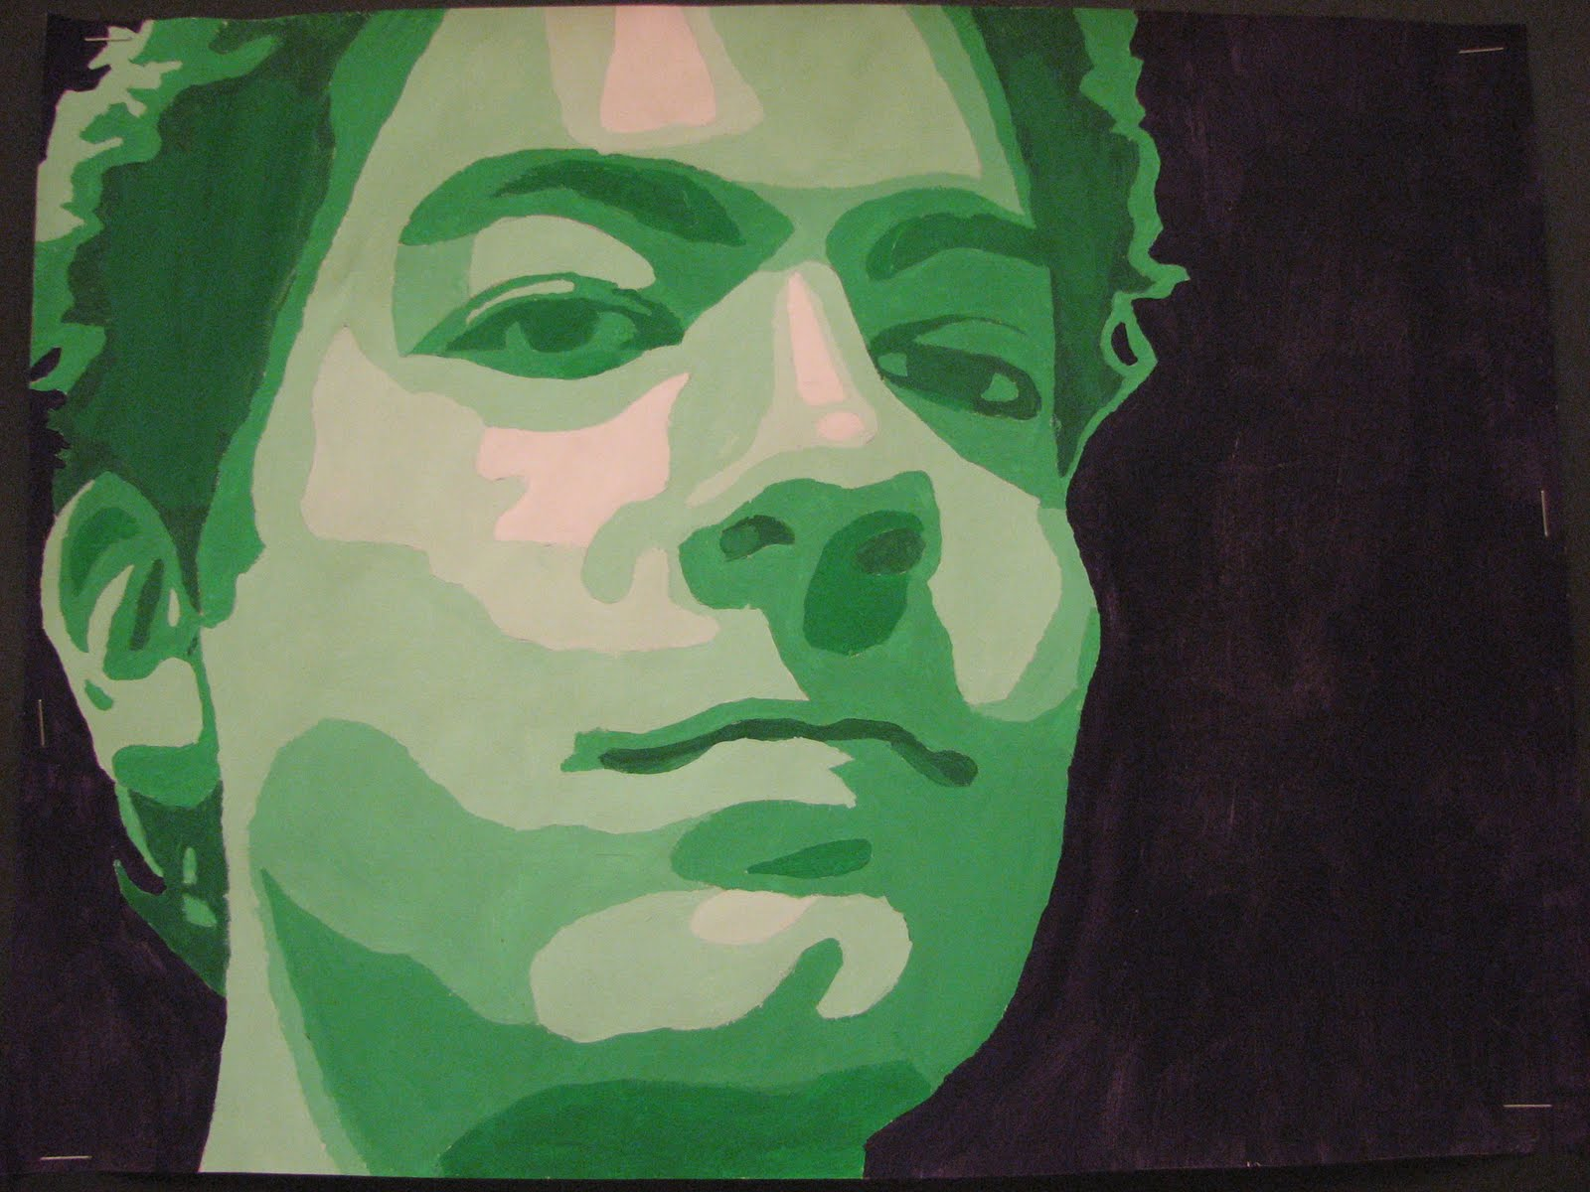

Slide 14
