Slide 1
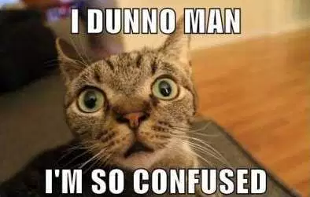
What is the definition of ‘value’?!
The lightness or darkness of a color

Slide 2
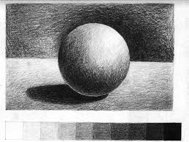
Value?! What does that look like?!

Slide 3
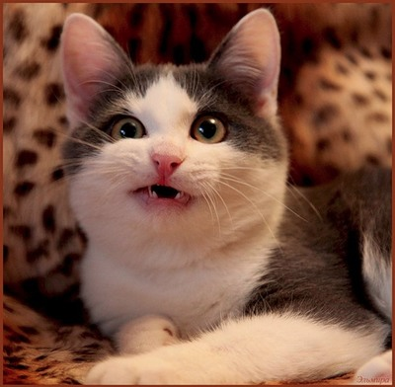
But, Ms. J, how can I create value if I am using a sharpie?!

Slide 4
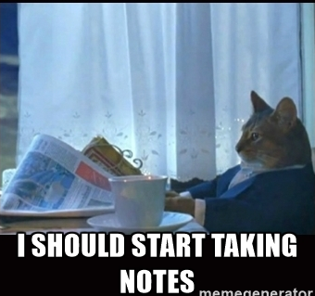
Three Ways to Create Value with Patterns
Design elements are closer together
Using more shapes of black
Line thickness

Slide 5
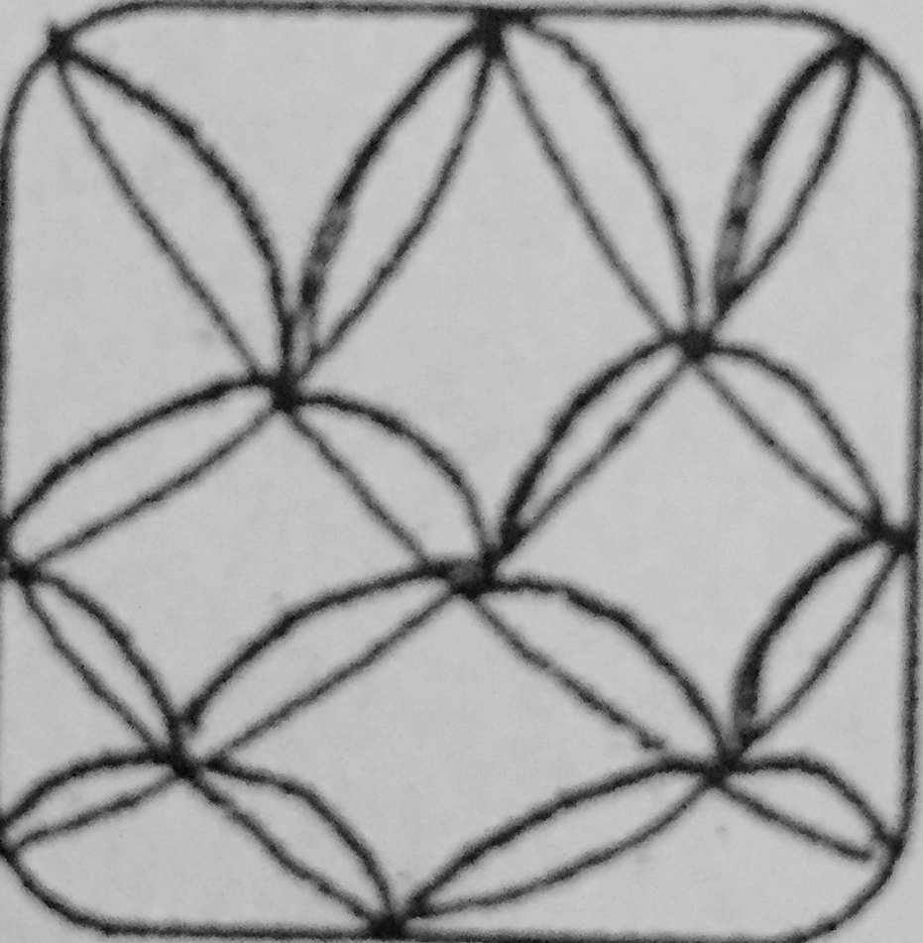
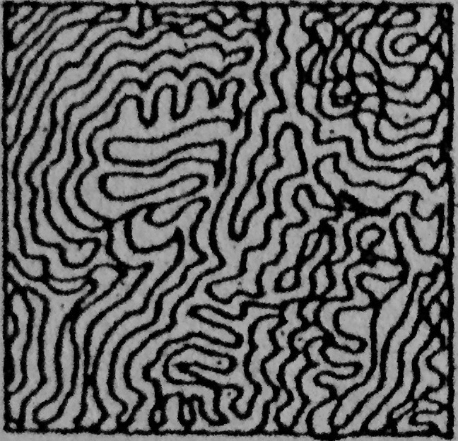
Design elements are closer together

Slide 6
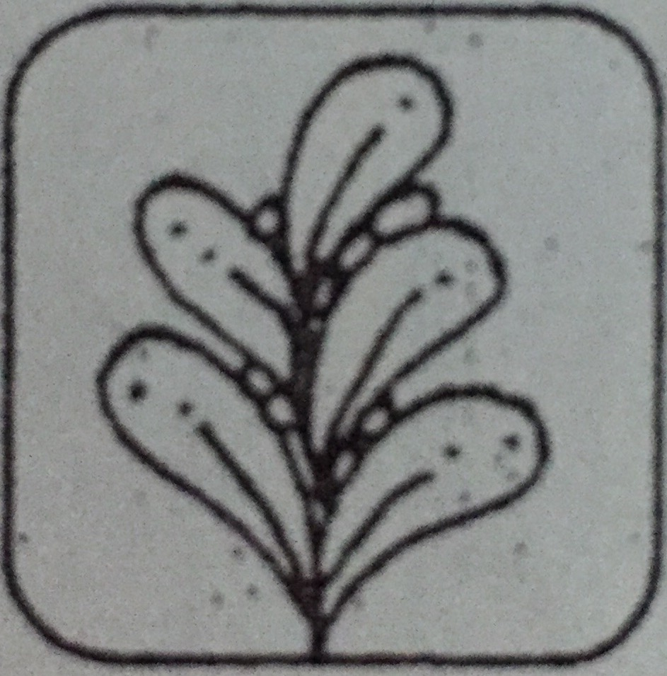
Using more shapes of black
Negative space
Positive space
the space around and between the subject(s) of an image
the subject or main design element

Slide 7
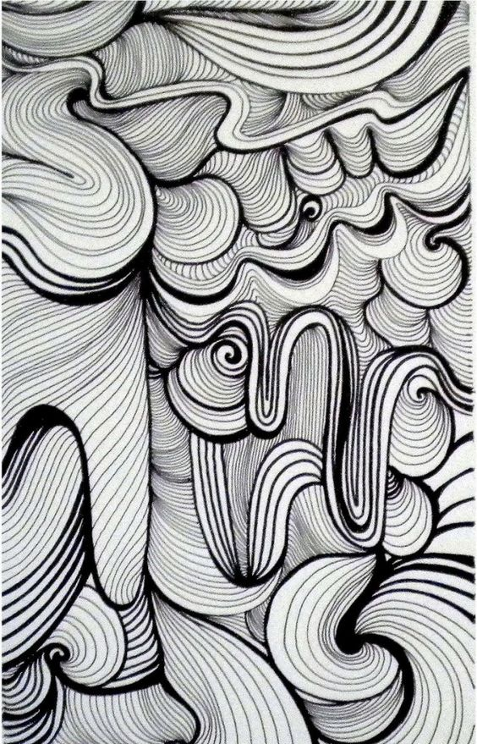
Line thickness
Lighter value
Darker value

Slide 8
Zentangle Tile Project
Two 5 inch by 5 inch squares, these are your tiles!
Each tile must have at least three different Zentangle patterns
You cannot use the same pattern twice
Each tile must have at least two different values
Due beginning of the class Monday

Slide 9
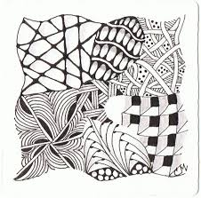
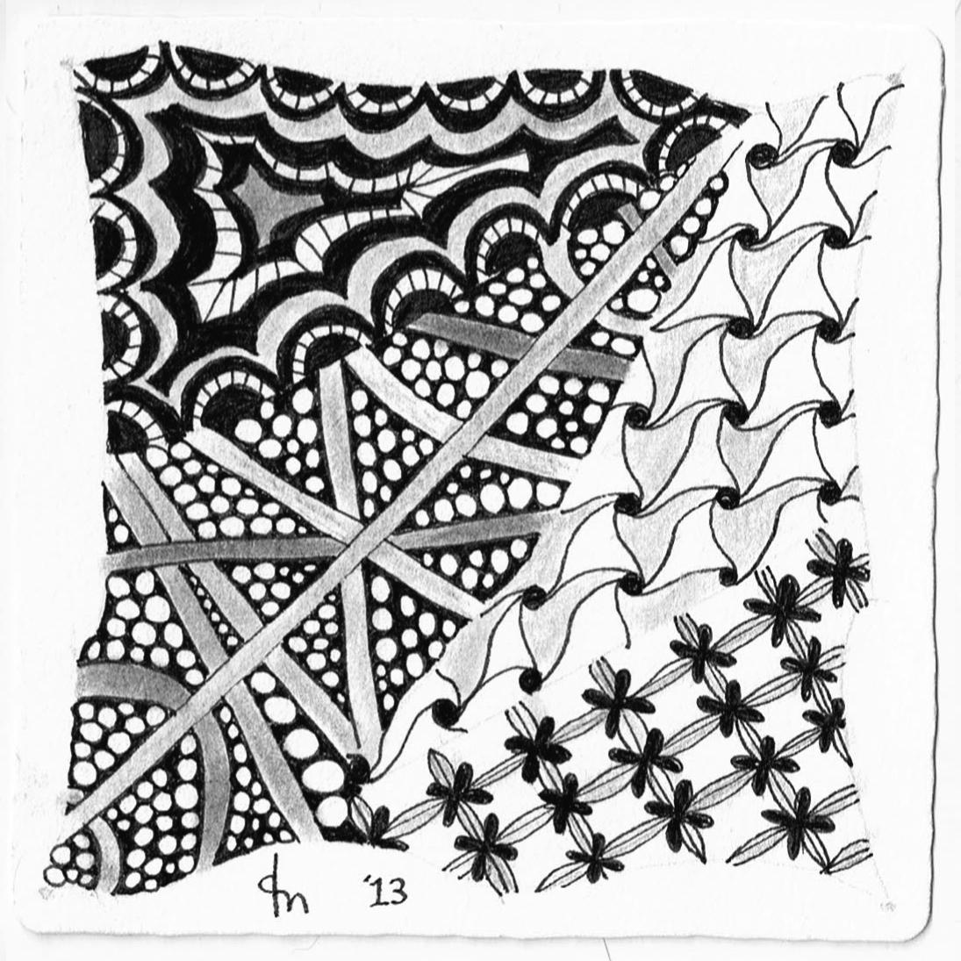

Slide 10
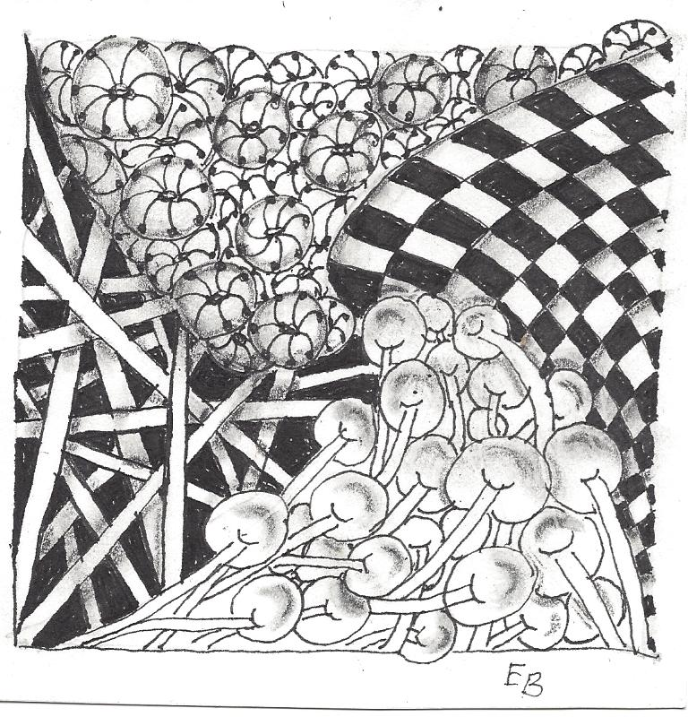
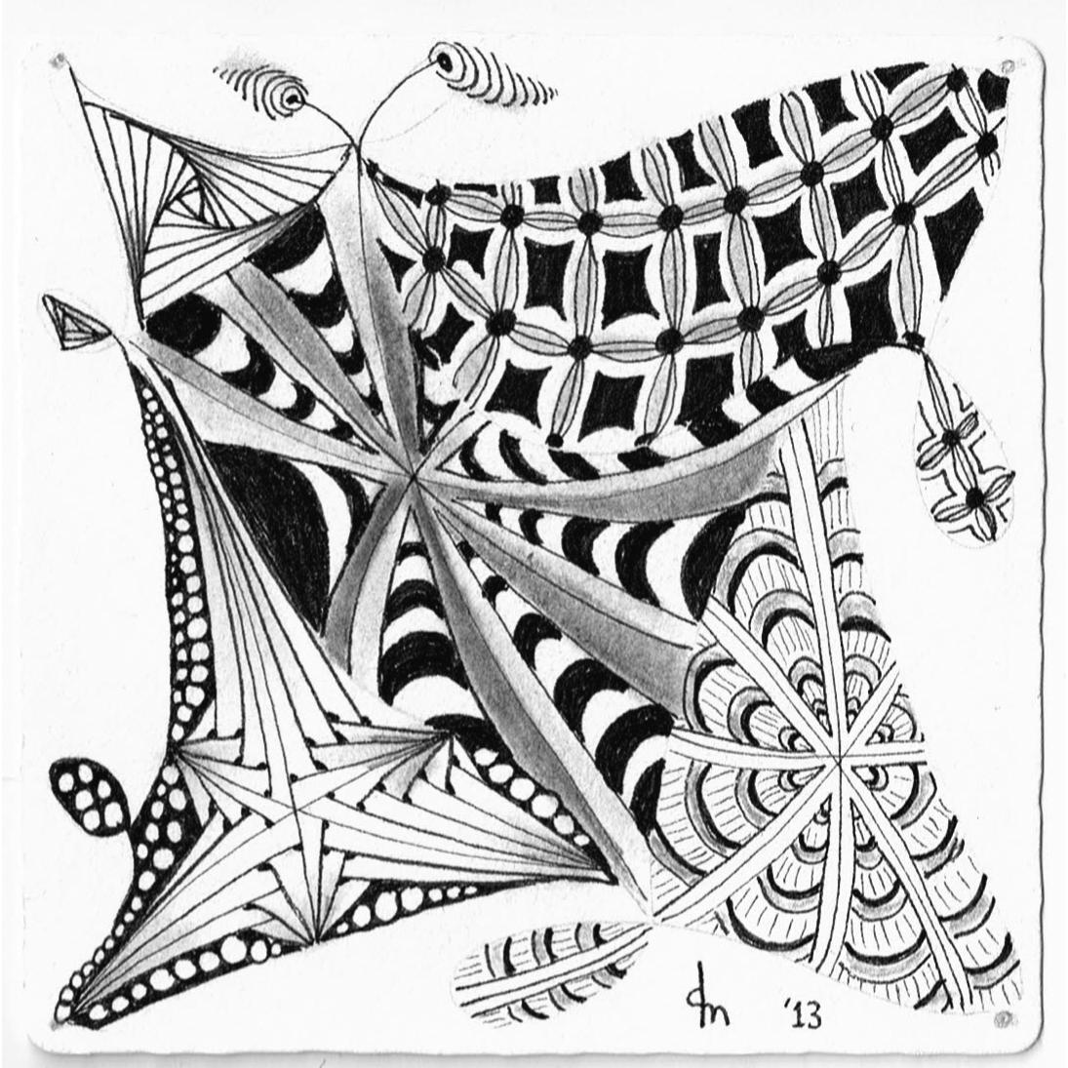

Slide 11
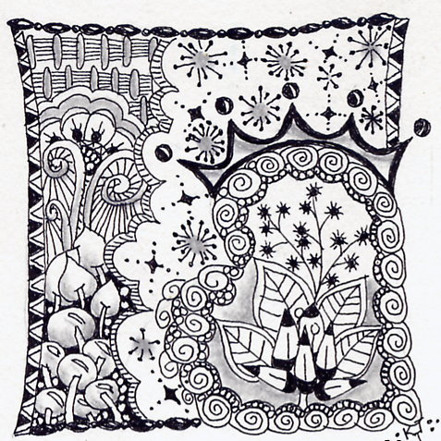
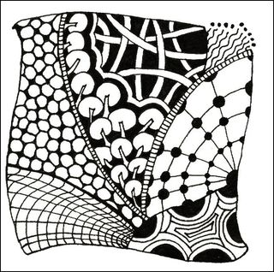

Slide 12
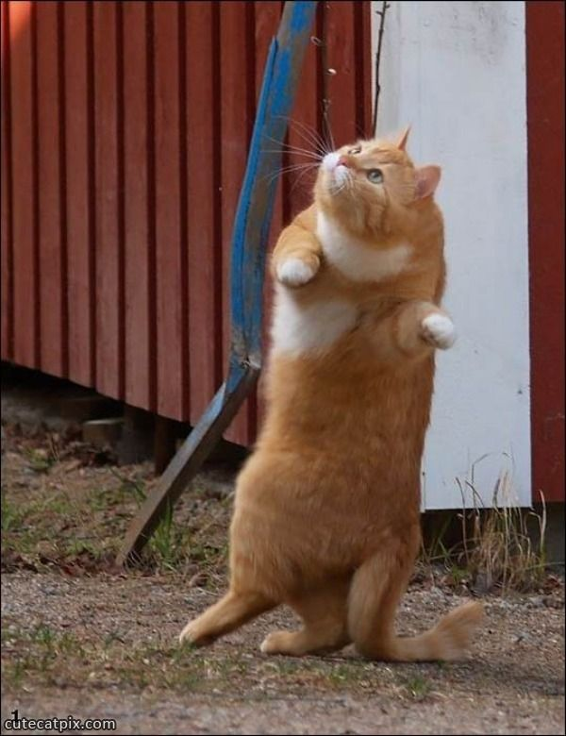
STAND UP!

